Slide 1
WDES (Workforce Disability Equality Standard)
Report 2025 - 2026

Slide 2
Contents
Introduction | Equality Diversity Inclusion and Engagement Manager
WDES Indicator 1 | Headcount
WDES Indicator 2 | Recruitment
WDES Indicator 3 | Disciplinary
WDES Indicator 4a | In the last 12 months, percentage of staff experiencing harassment, bullying or abuse from Patients/service users, their relatives or other members of the public
WDES Indicator 4b | In the last 12 months, percentage of staff experiencing harassment, bullying or abuse from managers
WDES Indicator 4c | In the last 12 months, percentage of staff experiencing harassment, bullying or abuse from colleagues
WDES Indicator 4d | In the last 12 months, percentage of staff experiencing harassment, bullying or abuse they or their colleague reported it
WDES Indicator 5 | The percentage of staff who believed that their organisation provided equal opportunities for career progression or promotion
WDES Indicator 6 | Percentage of disabled staff compared to non-disabled staff saying that they have felt pressure from their manager to come to work, despite not feeling well enough to perform their duties.
WDES Indicator 7 | The percentage of staff who were satisfied with the extent to which their organisation values their work
WDES Indicator 8 | The percentage of Disabled staff whose employer had made reasonable adjustments to enable them to carry out their work
WDES Indicator 9 | The NHS staff survey-based staff engagement score
WDES Indicator 10 | Overall board membership
Notes:
Add WRES

Slide 3
We know there is more to do.
I want to be open: staff with disabilities do not always have positive experiences of fairness, safety or opportunity at Gateshead Health. They are having worse experiences than any other group of staff, and that is not ok.
Our workforce data and colleague feedback matter. They show that barriers, bias and unequal outcomes remain. We need to acknowledge this honestly and respond with focus, care and sustained action.
I want every colleague to feel they belong, can speak up safely and have the same opportunity to progress. There is more to do, and we are committed to doing it.
Every leader and every team must reflect honestly on what is happening, take responsibility for improvements within their control and work together to make a difference.
We must all;
Challenge prejudice and discrimination.
Remove barriers in our systems.
Act on what staff tell us.
Measure whether our actions improve people’s experiences — and keep learning as we go.
Our colleagues deserve fairness, respect and opportunity. Together, we can and must keep improving.
Amanda Venner, Executive Director of People and OD
Gateshead Health NHS Foundation Trust

Slide 4
WDES Metrics
Workforce indicators : For each of these four workforce Indicators, compare the data for Disabled and Non-Disabled staff | DATA SOURCE
Percentage of staff in each of the AfC Bands 1-9, VSM (including executive board members), Medical and Dental and other staff , compared with the percentage of staff in the overall workforce disaggregated by: - Non-Clinical staff - Clinical staff -of which Non-Medical staff - Medical and Dental staff | ESR
2. Relative likelihood of staff being appointed from shortlisting across all posts (both external and internal posts). | ESR
3. Relative likelihood of staff entering the formal disciplinary process, as measured by entry into a formal disciplinary investigation | PEOPLE AND OD RECORDS
4. Relative likelihood of staff accessing non-mandatory training and CPD | PEOPLE AND OD RECORDS
National NHS Staff Survey indicators For each of the four staff survey indicators, compare the outcomes of the responses for Disabled and Non-Disabled staff | DATA NHSS
5. Percentage of staff experiencing harassment, bullying or abuse from patients, relatives or the public in last 12 months 6. Percentage of staff experiencing harassment, bullying or abuse from staff in last 12 months 7. Percentage of staff believing that the trust provides equal opportunities for career progression or promotion 8. In the last 12 months have you personally experienced discrimination at work from any of the following? - Manager/team leader or other colleagues Board representation indicator: For this indicator, compare the difference for white and BME staff 9. Percentage difference between the organisations’ Board membership and its overall workforce disaggregated: - By voting membership of the Board - By executive membership of the Board | DATA SOURCE ESR

Slide 5
Key findings 2025 – 2026
Workforce representation
There was a rise of 1.82% in staff indicating a disability, rising from 5.2% in 2024 to 7.0% in 2026
Career Progression
Disabled staff and Non-Disabled Staff held a stronger belief that the Trust provided equal opportunities for career progression or promotion. This figure has however decreased in 2025
For Disabled staff by 9.7% (61% to 51.3%)
For Non-Disabled staff by 8.5% (65.8% to 57.3%)
Recruitment
Data collected shows that the likelihood of Non-Disabled applicants being appointed compared with Disabled applicants was 1.32
Disciplinary Process
- The data shows that the relative likelihood of disabled staff entering the formal capability process compared to non-disabled staff has dropped from 3.24 last year to 2.66 this year
Board Representation
The difference between Disabled representation on the board and in the workforce was +1.8%.
Reasonable adjustments are undertaken
73.7%of staff with disabilities stated that the Trust had made adequate adjustments for them to carry out their work. This figure though, has decreased by 7% ( 80.7% to 73.7% )
Staff satisfaction with the extent to which the Trust values their work
The figures show that there has been a consistency around the 30% mark for Disabled groups and the mid 45% for Non-Disabled staff.
Data shows a 7.2% difference between the two groups (2025). This figure is marginally better than the 2024 figure which was indicating a 7.6% difference.
Harassment and Bullying
Decrease by 0.1% abuse from Patients , relatives or public
Increase of 0.5% abuse from Managers
Decrease of 1.2% abuse from Colleagues
Decrease of 4.3% of individuals or colleagues reporting harassment / abuse
Pressure to come to work
Shows an increase for staff who have a Disability by 2.8% (up from 25.3%)
For non-disabled staff, this figure has also increased by 1.3% (up from 14%)

Slide 6
Key achievements from last 12 months
Oliver McGowan Mandatory Training rolling out across the Trust to build knowledge in supporting patients and staff with learning difficulties.
Level 2 Disability Confident accreditation achieved.
Project Choice programme continues to provide work experience opportunities for individuals with additional learning needs.
Launched a new ‘Supporting Staff with their Mental Health’ guide, providing practical support and signposting for staff and managers.
Strengthened prevention-focused approaches to staff wellbeing, using absence and health needs data to target support, improve early intervention, and identify trends affecting staff health and retention.
ADHD guidance introduced to support managers and colleagues.
Recruitment and Selection programme updated to strengthen consideration of reasonable adjustments.
ESR self-service promoted to improve the recording of disability and protected characteristic data.
Disability Rights Month, Neurodiversity Celebration Week and wider EDI initiatives promoted in partnership with the D-Ability Network.
Culture and Experience Day introduced as a core leadership development programme, covering civility, discrimination, bullying and harassment, sexual safety, and inclusive leadership.
Inclusivity training available to all staff to increase awareness and understanding of equality, diversity and inclusion.
Civility Awareness Training available to all staff to support respectful workplace behaviours and challenge incivility.
Staff Experience and Inclusion Group established, with staff network representation helping shape culture and EDI initiatives.
ESR self-service functionality available for staff to update personal and protected characteristic information.

Slide 7
WDES Indicator 1 (1of 3) Overall
Percentage of Staff declaring a disability compared to percentage of Staff not declaring their disability status
 | 19/20 | 20/21 | 21/22 | 22/23 | 23/24 | 24/25 | 25/26
Disabled | 5.41% | 5.33% | 5.22% | 5.24% | 5.34% | 5.35% | 7.0%
Non - Disabled | 79.91% | 82.04% | 83.04% | 87.35% | 86.19% | 86.67% | 86.10%
Unknown | 14.68% | 12.63% | 11.74% | 7.41% | 8.47% | 7.98% | 6.90%
The NHS Staff Survey offers another estimate of the representation of Disabled staff in the workforce. Typically, a greater percentage of survey respondents declare whether they have a disability or not than do staff through ESR although not all staff respond to the staff survey.
The NHS Staff Survey asks, “Do you have any physical or mental health conditions or illnesses lasting or expected to last for 12 months or more?”
In the 2025 Staff Survey, the overall staff results show that:
7.0% of staff declared that they had a disability.
86.10% of respondents declared that they did not have a disability.
There has been an increase by 1.7% of staff declaring a disability
There has been a decrease by 0.57% of staff who do not have a disability
There has also been a decrease by 1.08% of staff who have either not declared their disability status or their disability is unknown.
Action 3 in the action plan aims to support improvement with this indicator
Contents
Indicator 1
Indicator 2
Indicator 3
Indicator 4a
Indicator 4b
Indicator 4c
Indicator 4d
Indicator 5
Indicator 6
Indicator 7
Indicator 8
Indicator 9
Indicator 10

Slide 8
WDES Indicator 1( 2 of 3) Non-clinical
Percentage of Staff declaring a disability compared to percentage of Staff not declaring their disability status
Pay Band |  | Disabled |  | Non-Disabled |  | Unknown |  | Overall Total
Under Band 1 | Headcount | 0 | 0.0% | 0 | 0.0% | 0 | 0.0% | 0
Bands 1 | Headcount | 0 | 0.0% | 0 | 0.0% | 0 | 0.0% | 0
Bands 2 | Headcount | 44 | 6.8% | 572 | 88.5% | 30 | 4.6% | 646
Bands 3 | Headcount | 26 | 9.2% | 246 | 87.2% | 10 | 3.5% | 282
Bands 4 | Headcount | 18 | 7.1% | 223 | 88.5% | 11 | 4.4% | 252
Bands 5 | Headcount | 10 | 6.5% | 137 | 89.0% | 7 | 4.5% | 154
Bands 6 | Headcount | 7 | 7.7% | 82 | 90.1% | 2 | 2.2% | 91
Bands 7 | Headcount | 7 | 9.9% | 62 | 87.3% | 2 | 2.8% | 71
Bands 8a | Headcount | 1 | 3.7% | 25 | 92.6% | 1 | 3.7% | 27
Bands 8b | Headcount | 3 | 8.8% | 31 | 91.2% | 0 | 0.0% | 34
Bands 8c | Headcount | 0 | 0.0% | 9 | 90.0% | 1 | 10.0% | 10
Bands 8d | Headcount | 0 | 0.0% | 10 | 90.9% | 1 | 9.1% | 11
Bands 9 | Headcount | 0 | 0.0% | 7 | 100.0% | 0 | 0.0% | 7
VSM | Headcount | 0 | 0.0% | 4 | 100.0% | 0 | 0.0% | 4
Cluster 1: AfC Bands <1 to 4 | Auto-Calculated | 88 | 7.5% | 1041 | 88.2% | 51 | 4.3% | 1180
Cluster 2: AfC bands 5 to 7 | Auto-Calculated | 24 | 7.6% | 281 | 88.9% | 11 | 3.5% | 316
Cluster 3: AfC bands 8a and 8b | Auto-Calculated | 4 | 6.6% | 56 | 91.8% | 1 | 1.6% | 61
Cluster 4: AfC bands 8c to VSM | Auto-Calculated | 0 | 0.0% | 30 | 93.8% | 2 | 6.3% | 32
Total Non-Clinical | Auto-Calculated | 116 | 7.3% | 1408 | 88.6% | 65 | 4.1% | 1589
Cluster 1 shows that in Bands 1- 4 (7.5%) of staff are disabled
Cluster 2 shows that in Bands 5-7 (7.6%) of staff are disabled.
Cluster 3 shows that in Bands 8a – 8b (6.6%) of staff are disabled.
However, it is important to note that while percentages may be virtually similar, number of staff in all of the clusters are not the same.
Similarly for staff who are not disabled, in the same clusters the figures are in the top 80% - 90%
Overall:
7.3 % of staff have declared that they have a disability
88.6% indicate they are not disabled and
The disability of 4.1% is unknown
Action 3 in the action plan aims to support improvement with this indicator
Contents
Indicator 1
Indicator 2
Indicator 3
Indicator 4a
Indicator 4b
Indicator 4c
Indicator 4d
Indicator 5
Indicator 6
Indicator 7
Indicator 8
Indicator 9
Indicator 10

Slide 9
WDES Indicator 1( 3 of 3) Clinical
Percentage of Staff declaring a disability compared to percentage of Staff not declaring their disability status
Pay Band |  | Disabled |  | Non-Disabled |  | Unknown |  | Overall Total
Under Band 1 | Headcount | 0 | 0.00% | 0 | 0.00% | 0 | 0.00% | 0
Bands 1 | Headcount | 0 | 0.00% | 0 | 0.00% | 0 | 0.00% | 0
Bands 2 | Headcount | 22 | 11.46% | 155 | 80.73% | 15 | 7.81% | 192
Bands 3 | Headcount | 38 | 6.14% | 538 | 86.91% | 43 | 6.95% | 619
Bands 4 | Headcount | 13 | 7.14% | 164 | 90.11% | 5 | 2.75% | 182
Bands 5 | Headcount | 69 | 7.42% | 726 | 78.06% | 135 | 14.52% | 930
Bands 6 | Headcount | 51 | 7.32% | 607 | 87.09% | 39 | 5.60% | 697
Bands 7 | Headcount | 27 | 6.32% | 376 | 88.06% | 24 | 5.62% | 427
Bands 8a | Headcount | 8 | 6.35% | 114 | 90.48% | 4 | 3.17% | 126
Bands 8b | Headcount | 2 | 6.45% | 26 | 83.87% | 3 | 9.68% | 31
Bands 8c | Headcount | 0 | 0.00% | 6 | 100.00% | 0 | 0.00% | 6
Bands 8d | Headcount | 0 | 0.00% | 5 | 100.00% | 0 | 0.00% | 5
Bands 9 | Headcount | 0 | 0.00% | 2 | 100.00% | 0 | 0.00% | 2
VSM | Headcount | 0 | 0.00% | 1 | 100.00% | 0 | 0.00% | 1
Cluster 1: AfC Bands <1 to 4 | Auto-Calculated | 73 | 7.4% | 857 | 86.3% | 63 | 6.3% | 993
Cluster 2: AfC bands 5 to 7 | Auto-Calculated | 147 | 7.2% | 1709 | 83.2% | 198 | 9.6% | 2054
Cluster 3: AfC bands 8a and 8b | Auto-Calculated | 10 | 6.4% | 140 | 89.2% | 7 | 4.5% | 157
Cluster 4: AfC bands 8c to VSM | Auto-Calculated | 0 | 0.0% | 14 | 100.0% | 0 | 0.0% | 14
Total Non-Clinical | Auto-Calculated | 230 | 7.1% | 2720 | 84.5% | 268 | 8.3% | 3218
 |  | Disabled |  | Non-Disabled |  | Unknown |  | Overall Total
Medical & Dental Staff, Consultants | Headcount | 7 | 2.90% | 212 | 87.97% | 22 | 9.13% | 241
Medical & Dental Staff, Non-Consultants career grade | Headcount | 2 | 8.33% | 21 | 87.50% | 1 | 4.17% | 24
Medical & Dental Staff, Medical and dental trainee grades | Headcount | 6 | 6.82% | 82 | 93.18% | 0 | 0.00% | 88
Total Medical and Dental | Auto-Calculated | 15 | 4.25% | 315 | 89.24% | 23 | 6.52% | 353
Number of staff in workforce | Auto-Calculated | 361 | 7.00% | 4443 | 86.10% | 356 | 6.90% | 5160
Out of the 3218 Clinical staff overall:
7.1% have declared a disability
84.5% are not Disabled
8.3% of staff members disability status is unknown
Specifically with the Medical and Dental category
4.25% have declared a Disability
89.24% are not Disabled
6.25% of staff members disability status is unknown
Contents
Indicator 1
Indicator 2
Indicator 3
Indicator 4a
Indicator 4b
Indicator 4c
Indicator 4d
Indicator 5
Indicator 6
Indicator 7
Indicator 8
Indicator 9
Indicator 10

Slide 10
Indicator 2
The relative likelihood of non-disabled applicants being appointed from shortlisting compared to Disabled applicants
2025/2026 |  | Disabled | Non-Disabled | Unknown | Overall Total
Number of shortlisted applicants | Headcount | 237 (9.8%) | 2180 (90.2%) | 0 | 2417
Number appointed from shortlisting | Headcount | 44 (7.62%) | 533 (92.4%) | 0 | 577
Likelihood of shortlisting/appointed | Auto-Calculated | 0.18 | 0.24 | 0
Relative likelihood of non-disabled candidates being appointed from shortlisting compared to Disabled candidates | Auto-Calculated | 1.31
A figure less than 1.0 would mean that disabled applicants are more likely to be appointed than non-disabled applicants
In respect of the 2025/26 figures:
237 (9.8%) Disabled candidates were shortlisted out of a total of 2417, resulting in 44 (7.62%) candidates being appointed
In comparison, 2180 (90.2%) Non-Disabled candidates were shortlisted out of a total of 2417 resulting in 533 (92.4%) candidates being appointed
Data captured shows that Relative likelihood of non-disabled candidates being appointed from shortlisting compared to Disabled candidates' applicants is 1.31.
This means that shortlisted non-disabled candidates were 31% more likely to be appointed than shortlisted disabled candidates in 2025/26.
This has worsened from last year (0.95-1.31)
As a Disability Confident employer, the Trust is committed to creating an inclusive and supportive workplace for everyone. We want to ensure that all our employees have access to the tools, adjustments, and support they need to thrive in their roles from when they start working for the Trust.
Previous Years Indicators | 19/20 | 20/21 | 21/22 | 22/23 | 23/24 | 24/25
 | 1.53 | 0.3 | 1.09 | 1.09 | 0.99 | 0.95
Action 1 and 4 in the action plan aims to support improvement with this indicator
Contents
Indicator 1
Indicator 2
Indicator 3
Indicator 4a
Indicator 4b
Indicator 4c
Indicator 4d
Indicator 5
Indicator 6
Indicator 7
Indicator 8
Indicator 9
Indicator 10

Slide 11
Indicator 3
The relative likelihood of Disabled staff entering the formal capability process compared to non-disabled staff
2025/2026 |  | Disabled | Non-Disabled | Unknown | Overall Total
Average number of staff entering the formal capability process over the last 2 years for any reason. (i.e. Total divided by 2.) | Headcount | 8 (16.32%) | 37 (75.5%) | 4 (81.6%) | 49
Of these, how many were on the grounds of ill-health? | Headcount | 0 | 0 | 0 | 0
Likelihood of staff entering the formal capability process | Auto-Calculated | 0.02 | 0.008 | 0.01
Relative likelihood of Disabled staff entering the formal capability process compared to Non-Disabled staff | Auto-Calculated | 2.66
This metric is based on data from a two- year rolling average of the current year and the previous year.
The metric applies to capability on the grounds of performance and not ill health.
Therefore, Staff entering the capability process for reasons of both performance and ill health are not included in this count.
The data shows that the relative likelihood of disabled staff entering the formal capability process compared to non-disabled staff has dropped from 3.24 last year to 2.66 this year
The actual numbers show that :
8 (16.32%) members of disabled staff entered the formal capability process
37 (75.5%) members of non-disabled staff entered the formal capability process
4 (8.16%) members of staff entering the formal capability process, disability status is unknown
This means that disabled staff were 2.66 times as likely as non-disabled staff to enter the formal performance capability process.
This improved from 3.24 times last year, but a substantial disparity remains
Previous Years Indicators | 19/20 | 20/21 | 21/22 | 22/23 | 23/24 | 24/25
 | 0 | 0.01 | 0 | 0 | 1.54 | 3.24
The Trust will ensure that all steps and reasonable adjustments are put in place for disabled individuals before any formal process starts.
Contents
Indicator 1
Indicator 2
Indicator 3
Indicator 4a
Indicator 4b
Indicator 4c
Indicator 4d
Indicator 5
Indicator 6
Indicator 7
Indicator 8
Indicator 9
Indicator 10
Notes:
Will send you narrative once I receive some details

Slide 12
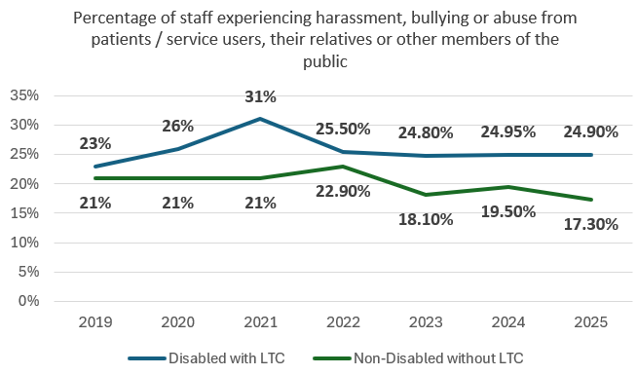
Indicator 4a WDES Staff Survey Data 2025
In the last 12 months, percentage of staff experiencing harassment, bullying or abuse from patients / service users, their relatives or other members of the public
 |  | 2019 | 2020 | 2021 | 2022 | 2023 | 2024 | 2025
a) Patients/service users, their relatives or other members of the public | Disabled with LTC | 23% | 26% | 31% | 25.50% | 24.80% | 24.95% | 24.90%
 | Non-Disabled without LTC | 21% | 21% | 21% | 22.90% | 18.10% | 19.50% | 17.30%
The percentage of staff who experienced harassment, bullying or abuse from patients, relatives or the public in the last 12 months:
Disabled staff experiences of harassment, bullying or abuse has dropped by (0.1% rounded up)
For Non-disabled staff experiences this figure has dropped by 2.2%
In comparing the 2025 data there is a 7.6% difference of staff experiencing harassment, bullying or abuse in respect of Disabled v Non-disabled staff
While the overall position improved, the inequality has widened because improvement was concentrated among non-disabled staff.
Action 2 in the action plan aims to support improvement with this indicator
Contents
Indicator 1
Indicator 2
Indicator 3
Indicator 4a
Indicator 4b
Indicator 4c
Indicator 4d
Indicator 5
Indicator 6
Indicator 7
Indicator 8
Indicator 9
Indicator 10
Notes:
DAN - could you please change the colour of the BME and White in the BAR charts just so that it can be seen as a stark difference.

Slide 13
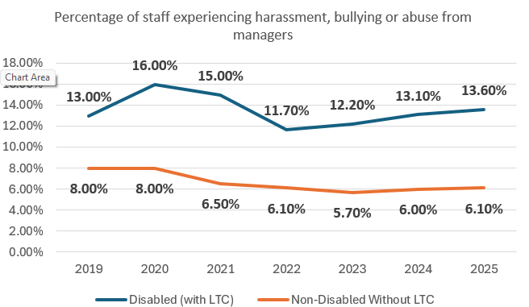
Indicator 4b WDES Staff Survey Data 2025
In the last 12 months, percentage of staff experiencing harassment, bullying or abuse from managers
 | 2019 | 2020 | 2021 | 2022 | 2023 | 2024 | 2025
Disabled (with LTC) | 13.0% | 16.0% | 15.0% | 11.7% | 12.2% | 13.1% | 13.6%
Non-Disabled Without LTC | 8.0% | 8.0% | 6.5% | 6.1% | 5.7% | 6.0% | 6.1%
The percentage of staff who experienced harassment, bullying or abuse from managers in the last 12 months:
The number of disabled staff experiencing harassment, bullying or abuse from managers in the last 12 months shows an increase of 0.5% whereas for non - disabled staff the increase was 0.1%
In the last year, the difference between Disabled and Non-disabled staff experiencing harassment, bullying or abuse from Managers is 7.5%.
Data collected also shows that disabled staff experiencing harassment, bullying or abuse from Managers has been relatively consistent
The number of disabled staff experiencing harassment bullying or abuse from their managers is more than twice as likely compared to Non- disabled staff
Action 2 in the action plan aims to support improvement with this indicator
Contents
Indicator 1
Indicator 2
Indicator 3
Indicator 4a
Indicator 4b
Indicator 4c
Indicator 4d
Indicator 5
Indicator 6
Indicator 7
Indicator 8
Indicator 9
Indicator 10
Notes:
DAN - could you please change the colour of the BME and White in the BAR charts just so that it can be seen as a stark difference.

Slide 14
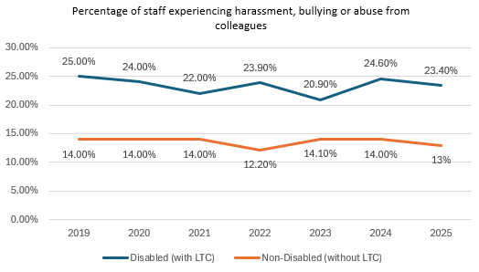
Indicator 4c WDES Staff Survey Data 2025
In the last 12 months, percentage of staff experiencing harassment, bullying or abuse from colleagues
 | 2019 | 2020 | 2021 | 2022 | 2023 | 2024 | 2025
Disabled (with LTC) | 25.0% | 24.0% | 22.0% | 23.9% | 20.9% | 24.6% | 23.4%
Non-Disabled (without LTC) | 14.0% | 14.0% | 14.0% | 12.2% | 14.1% | 14.0% | 13%
Disabled staff 23.4%, are nearly twice as likely to experience harassment, bullying or abuse than non-disabled staff 13%
For non-disabled staff the percentages have remained mostly consistent at 14% apart from a dip in 2022 (12.2%). This figure has increased to the 14% mark with a very small decrease (1.0%) in 2025
Comparing the 2025 data, the difference between the percentages of staff experiencing harassment, bullying or abuse from other colleagues in the last 12 months shows a differential for Staff with disabilities compared to staff who do not have a disability - the 2025 data showing a difference of 10.4%. There is a minuscule difference from the 2024 figures where it was 10.6%
It is also interesting to note that for Disabled groups the figure stands at a consistent 25+% mark with a very small dip in 2023. In a similar vein, non disabled groups also fall into the 14+% category.
Action 2 in the action plan aims to support improvement with this indicator
Contents
Indicator 1
Indicator 2
Indicator 3
Indicator 4a
Indicator 4b
Indicator 4c
Indicator 4d
Indicator 5
Indicator 6
Indicator 7
Indicator 8
Indicator 9
Indicator 10

Slide 15
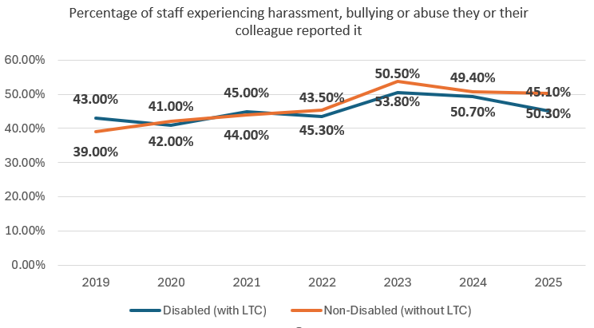
Indicator 4d WDES Staff Survey Data 2025
In the last 12 months, percentage of staff experiencing harassment, bullying or abuse they or their colleague reported it
 | 2019 | 2020 | 2021 | 2022 | 2023 | 2024 | 2025
Disabled (with LTC) | 43.0% | 41.0% | 45.0% | 43.5% | 50.5% | 49.4% | 45.1%
Non-Disabled (without LTC) | 39.0% | 42.0% | 44.0% | 45.3% | 53.8% | 50.7% | 50.3%
The percentage of staff who indicated that they or a colleague reported an incident of harassment, bullying or abuse experienced at work was:
Similar for Disabled staff, 45.1%, and for non-disabled staff, 50.3%
fewer than half of disabled staff who experienced harassment, bullying or abuse said it was reported.
For both groups there has been a slight drop in this metric in 2025
Signing up to the Z tolerance, delivering Incivility Saves Lives, and the ongoing work around harassment and bullying may well account for the rise in reporting.
While a poster campaign around Incivility has been produced, aspects pertaining specifically to addressing Disability equality will be actioned e.g. Recruitment, Inclusivity training.
under-reporting remains a concern, with disabled staff less likely to report incidents.
Action 2 in the action plan aims to support improvement with this indicator
Contents
Indicator 1
Indicator 2
Indicator 3
Indicator 4a
Indicator 4b
Indicator 4c
Indicator 4d
Indicator 5
Indicator 6
Indicator 7
Indicator 8
Indicator 9
Indicator 10

Slide 16
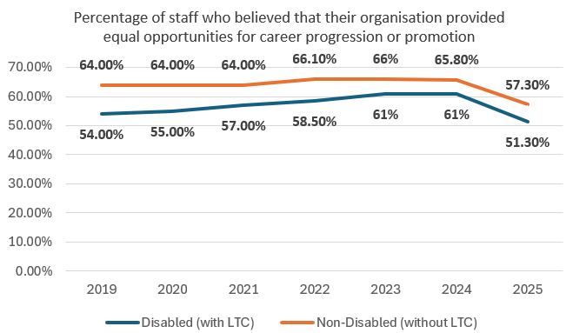
WDES Indicator 5
The percentage of staff who believed that their organisation provided equal opportunities for career progression or promotion
 | 2019 | 2020 | 2021 | 2022 | 2023 | 2024 | 2025
Disabled (with LTC) | 54.0% | 55.0% | 57.0% | 58.5% | 61% | 61% | 51.3%
Non-Disabled (without LTC) | 64.0% | 64.0% | 64.0% | 66.1% | 66% | 65.8% | 57.3%
Since 2019 to date, Disabled staff and Non-Disabled Staff held a stronger belief that the Trust provided equal opportunities for career progression or promotion.
For Disabled staff - The data has fluctuated in the 55% mark to a highest in 2023/2024, but decreased in 2025 by 9.7% to 51.3%
For Non-Disabled staff the figure has been in the mind 60%, but has dropped by 8.5% (65.8% to 57.3%)
confidence in fair career progression has fallen sharply for everyone and remains lower among disabled staff.
only about half of disabled staff believe promotion opportunities are equal
Action 1 and 4 in the action plan aims to support improvement with this indicator
Contents
Indicator 1
Indicator 2
Indicator 3
Indicator 4a
Indicator 4b
Indicator 4c
Indicator 4d
Indicator 5
Indicator 6
Indicator 7
Indicator 8
Indicator 9
Indicator 10

Slide 17
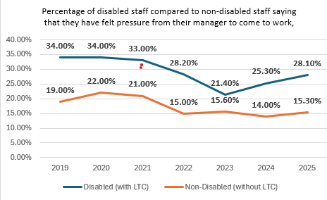
WDES Indicator 6
Percentage of disabled staff compared to non-disabled staff saying that they have felt pressure from their manager to come to work, despite not feeling well enough to perform their duties.
 | 2019 | 2020 | 2021 | 2022 | 2023 | 2024 | 2025
Disabled (with LTC) | 34.0% | 34.0% | 33.0% | 28.2% | 21.4% | 25.3% | 28.1%
Non-Disabled (without LTC) | 19.0% | 22.0% | 21.0% | 15.0% | 15.6% | 14.0% | 15.3%
The percentage of staff who felt pressure from their manager to come to work despite not feeling well enough to perform their duties:
Shows an increase for staff who have a Disability by 2.8% (up from 25.3% to 28.1%)
For non-disabled staff, this figure has also increased by 1.3% (up from14% to 15.3%)
Disabled staff are nearly twice as likely to feel pressured to work when too unwell
Previous indications around this indicator were linked to Covid, however, staff have reported that their personal health is often compromised due to the pressure to come to work. This is reflected within the latest data collected.
Information from the staff network has also indicated disabled staff will come to work whilst not feeling well through fear of triggering sickness stages in the absence policy. Additionally, Managers may not take the individuals disability into account and the network has also indicated that for some colleagues the pressure to come to work may be self imposed and this needs to be explored further.
Action 3 in the action plan aims to support improvement with this indicator
Contents
Indicator 1
Indicator 2
Indicator 3
Indicator 4a
Indicator 4b
Indicator 4c
Indicator 4d
Indicator 5
Indicator 6
Indicator 7
Indicator 8
Indicator 9
Indicator 10

Slide 18
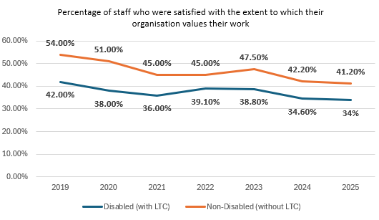
WDES Indicator 7
The percentage of staff who were satisfied with the extent to which their organisation values their work
 | 2019 | 2020 | 2021 | 2022 | 2023 | 2024 | 2025
Disabled (with LTC) | 42.0% | 38.0% | 36.0% | 39.1% | 38.8% | 34.6% | 34%
Non-Disabled (without LTC) | 54.0% | 51.0% | 45.0% | 45.0% | 47.5% | 42.2% | 41.2%
The percentage of staff who were satisfied with the extent to which their organisation values their work:
The data shows that Disabled staff continue to feel that their work is less valuable to the organisation than Non-Disabled staff. The figures show that there has been a consistency around the 30% mark for Disabled groups and the mid 45% for Non-Disabled staff.
Data shows a 7.2% difference between the two groups (2025). This figure is marginally better than the 2024 figure which was indicating a 7.6% difference.
The difference between disabled and non-disabled staff suggests that there is a greater need to fully understand the experiences and improve the ways in which people feel valued and heard.
Action 3 in the action plan aims to support improvement with this indicator
Contents
Indicator 1
Indicator 2
Indicator 3
Indicator 4a
Indicator 4b
Indicator 4c
Indicator 4d
Indicator 5
Indicator 6
Indicator 7
Indicator 8
Indicator 9
Indicator 10

Slide 19
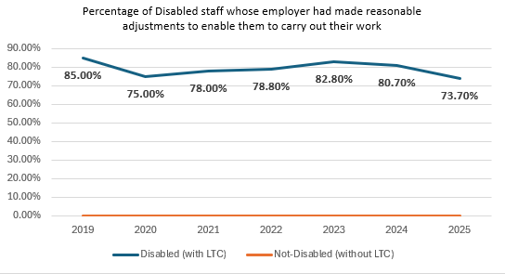
WDES Indicator 8
The percentage of Disabled staff whose employer had made reasonable adjustments to enable them to carry out their work
 | 2019 | 2020 | 2021 | 2022 | 2023 | 2024 | 2025
Disabled (with LTC) | 85.0% | 75.0% | 78.0% | 78.8% | 82.8% | 80.7% | 73.7%
Not-Disabled (without LTC) | 0.0% | 0.0% | 0.0% | 0.0% | 0.0% | 0.0% | 0%
Nearly three in four disabled staff (73.7%) say they receive adequate reasonable adjustments.
This fell sharply from 80.7% in 2024—a 7-point decline.
Undeclared disabilities may mean the full need is not visible.
Most disabled colleagues receive support, but provision has worsened and over a quarter do not report adequate adjustments.
Action 3 in the action plan aims to support improvement with this indicator
Contents
Indicator 1
Indicator 2
Indicator 3
Indicator 4a
Indicator 4b
Indicator 4c
Indicator 4d
Indicator 5
Indicator 6
Indicator 7
Indicator 8
Indicator 9
Indicator 10

Slide 20
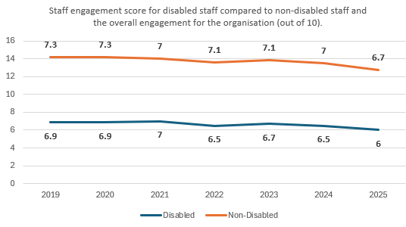
WDES Indicator 9
The NHS staff survey-based staff engagement score
 | Staff engagement score for disabled staff compared to non-disabled staff and the overall engagement for the organisation (out of 10).
 | 2019 | 2020 | 2021 | 2022 | 2023 | 2024 | 2025
Disabled | 6.9 | 6.9 | 7.0 | 6.5 | 6.7 | 6.5 | 6
Non-Disabled | 7.3 | 7.3 | 7.0 | 7.1 | 7.1 | 7.0 | 6.7
This indicator shows that over the last 7 years the engagement score for Disabled groups have been consistently around the mid 6.5 mark, whilst for the non-disabled groups has stood at 7.
The staff engagement score from 2025 for Disabled groups has dropped by 0.5 and Non-disabled staff has dropped by 0.3
The decrease suggests that work needs to be carried out to understand why disabled staff have worst experience at the Trust compared to other groups, to help us improve the ways in which staff feel valued, supported and heard.
Contents
Indicator 1
Indicator 2
Indicator 3
Indicator 4a
Indicator 4b
Indicator 4c
Indicator 4d
Indicator 5
Indicator 6
Indicator 7
Indicator 8
Indicator 9
Indicator 10

Slide 21
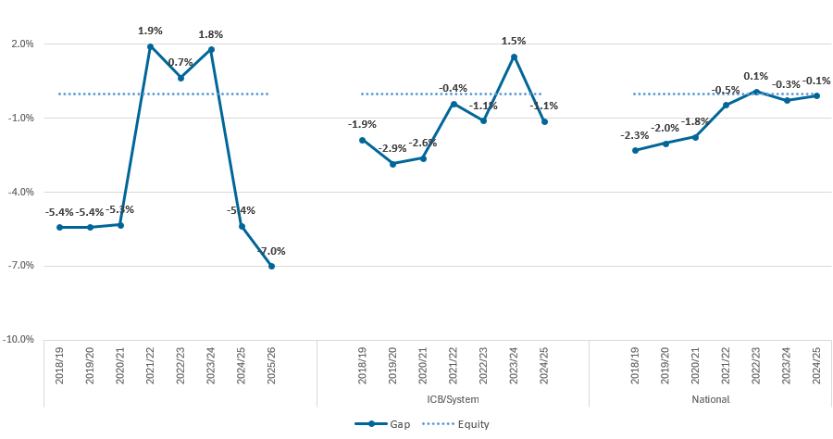
WDES Indicator 10
Overall board membership
As at the end of March 2026:
the difference between Disabled representation on the board and in the workforce was the same as the previous year +1.8%.
Disabled members were at least proportionately represented on the board in terms of a headcount.
Action 4 in the action plan aims to support improvement with this indicator
Contents
Indicator 1
Indicator 2
Indicator 3
Indicator 4a
Indicator 4b
Indicator 4c
Indicator 4d
Indicator 5
Indicator 6
Indicator 7
Indicator 8
Indicator 9
Indicator 10

Slide 22
WDES action plan
No | Action | WRES Indicator
1 | To reduce inequalities in recruitment, career progression, leadership development and access to opportunities. Strengthen Recruitment and Selection Policy so all recruitment at Band 8a and above and wherever possible at all levels, there is consideration for diversity of the applicants and reflect this within the panel representation i.e. interview panel members that have a disability. Actively promote the CPD and development offer via staff networks to increase awareness of development opportunities beyond mandatory learning to enhance skills and in-turn, employability prospects. | Indicators 2, 5
2 | To reduce experiences of bullying, harassment, discrimination and incivility. Arrange specific, targeted civility awareness sessions and FTSU sessions with all staff networks, to raise awareness and support confidence in raising concerns, incorporating changes to the grievance policy and let them know about triangulation meetings. Triangulate staff survey data where there are high levels of incivility reported through the staff survey, and high levels of protected characteristics to deliver targeted civility awareness sessions and offer managers support. Training for commissioning managers on recognising bias, making decisions cases proceed to formal processes etc. | Indicators 4abcd,

Slide 23
WDES action plan
No | Action | WRES Indicator
3 | To create a workplace where disabled colleagues feel supported, valued and able to thrive. Launch the Reasonable Adjustments Passport and associated guide for managers to support individuals with long-term health conditions or disabilities. Strengthen manager capability around disability inclusion and neurodiversity through awareness and development. Increase disability declaration rates through promotion via the staff networks | Indicators 1, 6, 7, 8
4 | To strengthen leadership accountability and ensure EDI outcomes are embedded within organisational governance arrangements. Introduce / strengthen EDI objectives into Executive and senior leader appraisal arrangements, need to be aligned to the priorities and actions agreed within this paper. Develop a Non-Executive Director development programme to increase diversity Align a member of the executive team to the staff networks acting as an ally and a key contact outside of the Executive Director of People and OD Raise awareness of the governance arrangements around EDI with staff networks to assure them issues are tacked and discussed appropriately | Indicators 2, 5, 10

