Slide 1
WRES (Workforce Race Equality Standard) Report 2025 - 2026

Slide 2
Contents
Introduction | Executive Director of People and Organisation Development
WRES Indicator 1 | Headcount: Clinical and Non Clinical
WRES Indicator 2 | Recruitment: Appointments from Shortlisting
WRES Indicator 3 | Disciplinary
WRES Indicator 4 | Non-Mandatory Training
WRES Indicator 5 | Percentage of staff experiencing harassment, bullying or abuse from patient’s relatives or public in the last 12 months
WRES Indicator 6 | Percentage of staff experiencing harassment, bullying or abuse from staff in the last 12 months
WRES Indicator 7 | Percentage of staff experiencing discrimination at work from a manager / team leader or other colleagues
WRES Indicator 8 | Percentage of staff believing that the trust provides equal opportunities for career progression or promotion
WRES Indicator 9 | Percentage difference between the organisations’ Board membership and its overall workforce disaggregated, by voting membership of the Board and executive membership of the Board
Notes:
Add WRES

Slide 3
We know there is more to do.
I want to be open: staff from a Global Ethnic Majority do not always have positive experiences of fairness, safety or opportunity at Gateshead Health.
Our workforce data and colleague feedback matter. They show that barriers, bias and unequal outcomes remain. We need to acknowledge this honestly and respond with focus, care and sustained action.
I want every colleague to feel they belong, can speak up safely and have the same opportunity to progress. There is more to do, and we are committed to doing it.
Every leader and every team must reflect honestly on what is happening, take responsibility for improvements within their control and work together to make a difference.
We must all;
Challenge racism and discrimination.
Remove barriers in our systems.
Act on what staff tell us.
Measure whether our actions improve people’s experiences — and keep learning as we go.
Our colleagues deserve fairness, respect and opportunity. Together, we can and must keep improving.
Amanda Venner, Executive Director of People and OD
Gateshead Health NHS Foundation Trust

Slide 4
WRES indicators
There are nine WRES indicators.
Four of the indicators focus on workforce data
  Percentage of staff in each of the AfC Bands 1-9, VSM, Medical and Dental and other staff , compared with the percentage of staff in the overall workforce
  Relative likelihood of staff being appointed from shortlisting across all posts (both external and internal posts).
  Relative likelihood of staff entering the formal disciplinary process, as measured by entry into a formal disciplinary investigation
  Relative likelihood of staff accessing non-mandatory training and CPD
Four are based on data from the national NHS Staff Survey questions and
  Percentage of staff experiencing harassment, bullying or abuse from patients, relatives or the public in last 12 months
  Percentage of staff experiencing harassment, bullying or abuse from staff in last 12 months
  Percentage of staff believing that the trust provides equal opportunities for career progression or promotion
  In the last 12 months have you personally experienced discrimination at work from any of the following- Manager/team leader or other colleagues
One indicator focuses upon BME representation on boards.
  Percentage difference between the organisations’ Board membership and its overall workforce
Based on the requirement from the National team, the Trust submitted the WRES data for Indicators 1 - 4 and indicator 9 on the National Data Collection Framework (DCF) before the end of 31st May 2026. The staff survey results for Indicators 5 to 8, are taken directly from the WRES publications available on the NHS Staff Survey website.
In the previous years there was information that was included within the indicators captured from the National Benchmarking report produced for the Trust. The next Benchmarking report (2025/ 2026) will not be available until October / November 2026 and as such this information is not included.

Slide 5
Definitions
Term | Definitions as per Technical Guidance by NHS England WRES Team.
White Staff | Includes White British, Irish and Eastern European and any “White other”.
BME Staff | Staff that are from a Black or Minority Ethnic background that are not white. Internally we use the term Global Ethnic Majority - GEM
Unknown | Refers to anyone who has not declared ethnicity.
Non-Mandatory Training | Any learning, education, training, or staff development activity undertaken by an employee, the completion of which is neither a statutory requirement (e.g. fire safety training) or mandated by the organisation. Accessing non-mandatory training and CPD, in this context refers to courses and developmental opportunities for which places were offered and accepted.

Slide 6
Key achievements from last 12 months
Recruitment and Selection programme revised with an enhanced focus on inclusive recruitment practices.
Culture and Experience Day introduced as a core leadership development programme, covering civility, discrimination, bullying and harassment, sexual safety, and inclusive leadership.
Inclusivity training available to all staff to increase awareness and understanding of equality, diversity and inclusion.
Civility Awareness Training available to all staff to support respectful workplace behaviours and challenge incivility.
Staff Experience and Inclusion Group established, with staff network representation helping shape culture and EDI initiatives.
Culture, Insight and Triangulation Meeting introduced to review EDI concerns alongside workforce and Freedom To Speak Up data and escalate issues where required.
EDI Dashboard developed and regularly reported through the Trust's governance structure.
First Ethnicity Pay Gap Report produced and presented to a Tier 1 Committee.
Bespoke EDI awareness sessions delivered in response to local team needs.
South Asian Heritage Month, Black History Month and other EDI initiatives actively promoted in partnership with the GEM Network.
ESR self-service functionality promoted to improve the recording of protected characteristic data.
Cultural Ambassador Programme reviewed to strengthen its future impact and effectiveness.

Slide 7
Key WRES findings 2025 – 2026
Workforce representation
- There was a 0.29% increase of BME staff, rising from 10.28% in 2024/25 to 11.18% in 2025/26.
- No representation at Very Senior Managers.
- Of the total 353 members of Medical staff, 59.49% are White and 35.98% are BME,
- 4.53% have not declared their ethnicity.
- BME representation was nearly half across all Medical roles, compared with White Staff
Recruitment
The relative likelihood of appointment for White staff has increased to 2.7.
The Ethnicity disparity for BME groups is 1.3.
Formal Disciplinary
The data indicates that whilst the disciplinary headcount for White staff stands at 60, for BME staff this figure is 7. In terms of ratios, for this KPI, the BME ratio has increased from 1.1 to 1.2 This figure has been on an increase since 2023/24.
Board Representation
Out of the total 15 White Board members, 7 are Executive Board members and 8 Non- Exec Board Members.
There is no BME representative
Harassment and Bullying
- BME Staff experiencing harassment, bullying or abuse from patients' relatives or public has decreased by 1.4% to 24.4%. Similarly, a small decrease for White staff but still around 19% - 25% across all the reporting years for both groups.
- Harassment, bullying or abuse from staff for both BME and White staff decreased (0.2% and 0.5% respectively). However, the figures are virtually the same as the above metric
- Harassment bullying or abuse from Managers / team leader or other colleagues for BME groups has increased by 0.2% up from 17.1%. For White staff, this figure has not changed, and still sits at 5.8% over the same period.
Career Progression
- Percentage of staff believing that the trust provides equal, opportunities for Career Progression or Promotion
In comparison with Data from last year, opportunities for BME staff have decreased by 6.2% and
For White Staff this figure has also decreased by 9.7%
Contents Page
Indicator 1
Indicator 2
Indicator 3
Indicator 4
Indicator 5
Indicator 6
Indicator 7
Indicator 8
Indicator 9

Slide 8
WRES Indicator 1 (1 of 3)
Percentage of BME staff vs VSM AFC Non-Clinical (headcount)
Non-Clinical Staff |  | BME |  | White |  | Unknown |  | 0verall Total
Under Band 1 | Headcount | 0 | 0.0% | 0 | 0.0% | 0 | 0.0% | 0
Bands 1 | Headcount | 0 | 0.0% | 0 | 0.0% | 0 | 0.0% | 0
Bands 2 | Headcount | 46 | 7.1% | 583 | 90.2% | 17 | 2.6% | 646
Bands 3 | Headcount | 7 | 2.5% | 271 | 96.1% | 4 | 1.4% | 282
Bands 4 | Headcount | 6 | 2.4% | 243 | 96.4% | 3 | 1.2% | 252
Bands 5 | Headcount | 4 | 2.6% | 145 | 94.2% | 5 | 3.2% | 154
Bands 6 | Headcount | 6 | 6.6% | 84 | 92.3% | 1 | 1.1% | 91
Bands 7 | Headcount | 2 | 2.8% | 68 | 95.8% | 1 | 1.4% | 71
Bands 8a | Headcount | 1 | 3.7% | 26 | 96.3% | 0 | 0.0% | 27
Bands 8b | Headcount | 0 | 0.0% | 34 | 100.0% | 0 | 0.0% | 34
Bands 8c | Headcount | 0 | 0.0% | 10 | 100.0% | 0 | 0.0% | 10
Bands 8d | Headcount | 0 | 0.0% | 11 | 100.0% | 0 | 0.0% | 11
Bands 9 | Headcount | 0 | 0.0% | 7 | 100.0% | 0 | 0.0% | 7
VSM | Headcount | 0 | 0.0% | 4 | 100.0% | 0 | 0.0% | 4
Cluster 1: AfC Bands <1 to 4 | Auto-Calculated | 59 | 5.0% | 1097 | 93.0% | 24 | 2.0% | 1180
Cluster 2: AfC bands 5 to 7 | Auto-Calculated | 12 | 3.8% | 297 | 94.0% | 7 | 2.2% | 316
Cluster 3: AfC bands 8a and 8b | Auto-Calculated | 1 | 1.6% | 60 | 98.4% | 0 | 0.0% | 61
Cluster 4: AfC bands 8c to VSM | Auto-Calculated | 0 | 0.0% | 32 | 100.0% | 0 | 0.0% | 32
Total Non-Clinical | Auto-Calculated | 72 | 4.5% | 1486 | 93.5% | 31 | 2.0% | 1589
As of 31st March 2026, the total Headcount of BME staff represented 5.0 % compared with 93% White staff across all Non-Clinical AfC roles.
Cluster Bands - 1 to 4 and under (administrative and technical support roles, estates office) show that:
BME representation was 5.0% and White 93%
2% of staff personnels ethnicity is unknown
Cluster 2 - Band 5 to 7 (graduate and management level roles) shows:
BME representation was 3.8% and White was 94%%
2.2% of staff personnels ethnicity is unknown
Cluster band 8a – 8b
- BME representation was 1.6% and White was 98.4%
Cluster band 8c – VSM
- BME representation was 0% and White was 100%
The data shows that as the Banding increases, the representation of BME Staff decreases. Band 2 has the highest number at 46 staff (7.1%) in comparison White staff at the same Band have a high representation 583 Staff (90.2%). These high percentages for White staff are reflected through Bands 2 to VSM
There is no BME representation above 8B
There is no BME staff representation at VSM
Action 1 and 3 in the action plan aims to support improvement with this indicator
Contents Page
Indicator 1
Indicator 2
Indicator 3
Indicator 4
Indicator 5
Indicator 6
Indicator 7
Indicator 8
Indicator 9

Slide 9
WRES Indicator 1 (2 of 3)
Percentage of BME staff vs VSM AFC Clinical (headcount)
Clinical Staff |  | BME |  | White |  | Unknown |  | Overall Total
Under Band 1 | Headcount | 0 | 0.00% | 0 | 0.00% | 0 | 0.00% | 0
Bands 1 | Headcount | 0 | 0.00% | 0 | 0.00% | 0 | 0.00% | 0
Bands 2 | Headcount | 13 | 6.77% | 178 | 92.71% | 1 | 0.52% | 192
Bands 3 | Headcount | 37 | 5.98% | 578 | 93.38% | 4 | 0.65% | 619
Bands 4 | Headcount | 10 | 5.49% | 170 | 93.41% | 2 | 1.10% | 182
Bands 5 | Headcount | 244 | 26.24% | 664 | 71.40% | 22 | 2.37% | 930
Bands 6 | Headcount | 54 | 7.75% | 636 | 91.25% | 7 | 1.00% | 697
Bands 7 | Headcount | 18 | 4.22% | 404 | 94.61% | 5 | 1.17% | 427
Bands 8a | Headcount | 3 | 2.38% | 123 | 97.62% | 0 | 0.00% | 126
Bands 8b | Headcount | 0 | 0.00% | 30 | 96.77% | 1 | 3.23% | 31
Bands 8c | Headcount | 0 | 0.00% | 6 | 100.00% | 0 | 0.00% | 6
Bands 8d | Headcount | 0 | 0.00% | 5 | 100.00% | 0 | 0.00% | 5
Bands 9 | Headcount | 0 | 0.00% | 2 | 100.00% | 0 | 0.00% | 2
VSM | Headcount | 0 | 0.00% | 1 | 100.00% | 0 | 0.00% | 1
Cluster 1: AfC Bands <1 to 4 | Auto-Calculated | 60 | 6.0% | 926 | 93.3% | 7 | 0.7% | 993
Cluster 2: AfC bands 5 to 7 | Auto-Calculated | 316 | 15.4% | 1704 | 83.0% | 34 | 1.7% | 2054
Cluster 3: AfC bands 8a and 8b | Auto-Calculated | 3 | 1.9% | 153 | 97.5% | 1 | 0.6% | 157
Cluster 4: AfC bands 8c to VSM | Auto-Calculated | 0 | 0.0% | 14 | 100.0% | 0 | 0.0% | 14
Total Clinical | Auto-Calculated | 379 | 11.8% | 2797 | 86.9% | 42 | 1.3% | 3218
As of 31st March 2026, the total Headcount of BME staff represented 11.8% compared with 86.9% White staff across all Clinical AfC roles.
Cluster 1 - Bands 1 to 4 and under (administrative and technical support roles, ) show that:
BME representation was 6.0% and White 93.3%. However far greater number of White staff in cluster compared with BME (926 v 60)
Cluster 2 - Band 5 to 7 (graduate and management level roles) shows:
BME representation was 15.4% and White was 83%. There are far greater numbers of White staff in this cluster compared with BME ( 1704 v 316)
Cluster 3- Band 8a – 8b
- BME representation was very low 1.9% and White was 97.5%
Cluster 4 - Band 8c – VSM
- BME representation was 0% and White was 100%
The data shows that as the Banding increases, the representation of BME Staff decreases significantly in comparison with their White counterparts. Biggest representation for BME staff is at Band 5 (26.24%)
In the Clinical Headcount Bands 8c to VSM shows that there were no BME representation
Action 1 and 3 in the action plan aims to support improvement with this indicator
Contents Page
Indicator 1
Indicator 2
Indicator 3
Indicator 4
Indicator 5
Indicator 6
Indicator 7
Indicator 8
Indicator 9

Slide 10
WRES Indicator 1 (3 of 3)
Percentage of BME staff vs VSM Clinical (headcount)
Medical Staff |  | BME |  | White |  | Unknown |  | Overall Total
Medical & Dental Staff, Consultants | Headcount | 82 | 34.02% | 151 | 62.66% | 8 | 3.32% | 241
of which Senior Medical Managers | Headcount | 0 | 0.00% | 2 | 100.00% | 0 | 0.00% | 2
Medical & Dental Staff, Non-Consultants career grade | Headcount | 9 | 37.50% | 15 | 62.50% | 0 | 0.00% | 24
Medical & Dental Staff, Medical and dental trainee grades | Headcount | 36 | 40.91% | 44 | 50.00% | 8 | 9.09% | 88
Medical & Dental Staff, Other |  | 0 |  | 0 |  | 0 |  | 0
Total Medical and Dental | Auto-Calculated | 127 | 35.98% | 210 | 59.49% | 16 | 4.53% | 353
Number of staff in workforce | Auto-Calculated | 578 | 11.20% | 4493 | 87.07% | 89 | 1.72% | 5160
The total figure indicated captures all staff who are in Non-Clinical, Clinical and Medical which equates to 5160
Amongst Medical and Dental staff, the breakdown shows that overall:
There are more White staff 59.49% than BME staff 35.98%
At Medical & Dental Staff, Consultants Level, White staff compared with BME staff are nearly double 151 (62.66%) v 82 (34.2%)
8 staff (3.32%) fall into the ‘Unknown’ category
Across the whole staff group, our BME colleagues make up 11.18 % of the workforce, an increase of 1.48% from last year.
Action 1 and 3 in the action plan aims to support improvement with this indicator
Contents Page
Indicator 1
Indicator 2
Indicator 3
Indicator 4
Indicator 5
Indicator 6
Indicator 7
Indicator 8
Indicator 9

Slide 11
Indicator 2
Relative likelihood of white applicants being appointed from shortlisting across all posts compared to BME applicants
Relative likelihood of white applicants being appointed from shortlisting across all posts compared to BME applicants | 18/ 19 | 19/ 20 | 20/ 21 | 21/22 | 22 /23 | 23 /24 | 24 /25 | 25/ 26
 | 3.08 | 1.8 | 0.70 | 0.72 | 0.69 | 0.83 | 0.59 | 2.7
 | Data collected for 2025/26 shows White applicants were 2.1 times more likely to be appointed from SL compared to BME applicants. The Ethnicity disparity in terms of BME groups is 1.3. Year on year fluctuation must also be taken into account. The higher the number, greater the chance of appointments.
A relative likelihood over a figure of 1 indicates that white applicants have a greater likelihood of being appointed
Previous data shows that BME were more likely to be appointed in comparison with their white colleagues in 2023/ 2024
The 2024/ 2025 figures show that the relative likelihood of white appointment had decreased by 0.24
There has been an increase in the 2025/2026 figures in that the relative likelihood of appointment for White staff has increased by 2.1 to 2.7
decrease by 0.24
Increase by 2.1
 |  | BME | White | Unknown | Total
Number of shortlisted applicants | Headcount | 660 (27.1%) | 1770 (72.8%) | 0 | 2430
Number appointed from shortlisting | Headcount | 89 (15.2%) | 493 (84.7%) | 0 | 582
Likelihood of shortlisting/appointed | Auto-Calculated | 0.13 | 0.27 | 0.000000
Relative likelihood of White candidates being appointed from shortlisting compared to BME candidates | Auto-Calculated | 2.06
Action 1 and 3 in the action plan aims to support improvement with this indicator
Contents Page
Indicator 1
Indicator 2
Indicator 3
Indicator 4
Indicator 5
Indicator 6
Indicator 7
Indicator 8
Indicator 9

Slide 12
Indicator 3
Relative likelihood of BME staff entering the formal disciplinary process compared to white staff.
Relative likelihood of BME staff entering the formal disciplinary process compared to white staff. | 18/19 | 19/20 | 20/21 | 21/22 | 22/23 | 23/24 | 24/25 | 25/26
 | 0.97 | 0 | 1.27 | 0 | 0 | 0.51 | 1.1 | 1.2
 | The disciplinary data has been extracted from Selenity and adjusted accordingly. The data indicates that whilst the disciplinary Headcount for White staff stands at 60, for BME staff this figure is 7. In terms of ratios for this KPI, the BME ratio has increased from 1.1 to 1.2. It is important to note that this figure have been on an increase since 2023/24
This data is captured form our internal reporting mechanisms.
Data collected pertains to formal disciplinary processes on grounds of conduct issues. These figures do not capture the informal process.
The Data shows that the figure has increased from 1.1 to 1.2 (reflecting 7 cases)
The 2025/26 figure show an increase by 0.1
Due to the limited volume of cases, the data should be viewed as indicative rather than evidence of an established trend.
Contents Page
Indicator 1
Indicator 2
Indicator 3
Indicator 4
Indicator 5
Indicator 6
Indicator 7
Indicator 8
Indicator 9
Notes:
Will send you narrative once I receive some details

Slide 13
Indicator 4 - Non-mandatory Training
Relative likelihood of white staff accessing non-mandatory training and CPD compared to BME staff
 | 2025/2026 | BME | White | Unknown | Total
Number of staff accessing non-mandatory training and CPD in the financial year | Headcount | 400 (13.5%) | 2520 (85%) | 47 (1.6%) | 2967
Likelihood of staff accessing non-mandatory training and CPD | Auto-Calculated | 0.69 | 0.56 | 0.52
Relative likelihood of White staff accessing non-mandatory training and CPD compared to BME staff | Auto-Calculated | 0.81
Aa at March 2026 the likelihood of white staff accessing non-mandatory training and CPD compared to BME staff was 0.81; not significantly different from "1.0" or equity.
Specifically, 2520 (85%) of White staff accessed non-mandatory training compared to 400 (13.5%) BME staff.
In % terms, the relative likelihood for staff accessing Non-Mandatory Training including those in the ‘Not stated / Not Given’ category show that
69% of BME staff had the likelihood of accessing Non-Mandatory training.
In comparison for both White and the Unknown category these figures are 56 % and 52% respectively
The data shows that there has been a drop from last years figure of White staff accessing mandatory training by (0.22)
Relative likelihood of white staff accessing non-mandatory training and CPD compared to BME staff | 19/20 | 20/21 | 21/22 | 22/23 | 23/24 | 24/25 | 25/26
 | 1.18 | 0.96 | 0 | 1 | 0.99 | 1.03 | 0.81
Action 1 in the action plan aims to support improvement with this indicator
Contents Page
Indicator 1
Indicator 2
Indicator 3
Indicator 4
Indicator 5
Indicator 6
Indicator 7
Indicator 8
Indicator 9

Slide 14
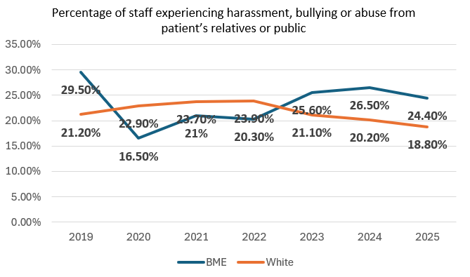
Indicator 5 WRES Staff Survey Data 2025
Percentage of staff experiencing harassment, bullying or abuse from patient’s relatives or public in the last 12 month
Staff Survey Indicators |  | 2019 | 2020 | 2021 | 2022 | 2023 | 2024 | 2025
Percentage of staff experiencing harassment, bullying or abuse from patient’s relatives or public in the last 12 months | BME | 29.5% | 16.5% | 21% | 20.3% | 25.6% | 26.5% | 24.4%
 | White | 21.2% | 22.9% | 23.7% | 23.9% | 21.1% | 20.2% | 18.8%
The figures over the last 7 years show:
For BME staff after the dip from 29.5% in 2019 to 16.5% in 2020. This figure had increased by 4.5% from 2020 to 2021 with a miniscule drop (0.7%) in 2022, but continued to rise for the next 2 years and dropped by 2.1% last year.
The figure for White staff also show an increase from 2020 (22.9%) and have hovered around this mark before showing a consistent drop in 2024/2025 with a 1.4% decrease.
The percentage decrease from to 2024/2025 for BME staff is very small (2.1%), it is a worry that across both groups, the percentage rates of staff experiencing harassment over the last 3 years are consistently within the 18% - 20+% mark
While there is an increase in the knowledge and confidence in reporting processes, providing Managers with Zero Tolerance / Civility Saves lives might be a reason for the drop. However, the figures are worrying.
Action 2 in the action plan aims to support improvement with this indicator
Contents Page
Indicator 1
Indicator 2
Indicator 3
Indicator 4
Indicator 5
Indicator 6
Indicator 7
Indicator 8
Indicator 9
Notes:
DAN - could you please change the colour of the BME and White in the BAR charts just so that it can be seen as a stark difference.

Slide 15
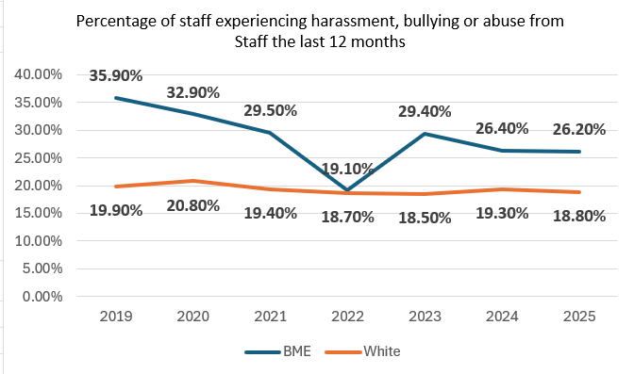
Indicator 6 WRES Staff Survey Data 2025
Percentage of staff experiencing harassment, bullying or abuse from staff in the last 12 months
 |  | 2019 | 2020 | 2021 | 2022 | 2023 | 2024 | 2025
Percentage of staff experiencing harassment, bullying or abuse from Staff the last 12 months | BME | 35.9% | 32.9% | 29.5% | 19.1% | 29.4% | 26.4% | 26.2%
 | White | 19.9% | 20.8% | 19.4% | 18.7% | 18.5% | 19.3% | 18.8%
This indicator shows that in the last 4 years:
BME staff experiences of harassment, bullying or abuse shows a decrease from 2023. This figure dropped by 0.2% in 2025.
For White staff experiences of harassment, bullying or abuse showed an increase of 0.8% in 2024 and has dropped by 0.5%
BME staff have consistently experienced higher levels of harassment, bullying and abuse from staff than white colleagues from 2019.
These figures are comparable with the regional figures. For BME staff the trajectory is likely impacted by factors out with the working environment as well as from within.
Action 2 in the action plan aims to support improvement with this indicator
Contents Page
Indicator 1
Indicator 2
Indicator 3
Indicator 4
Indicator 5
Indicator 6
Indicator 7
Indicator 8
Indicator 9

Slide 16
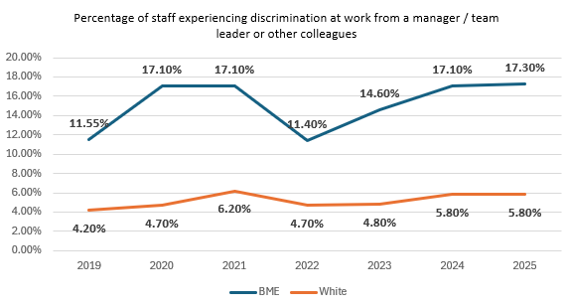
Indicator 7 WRES Staff Survey Data 2025
Percentage of staff experiencing discrimination at work from a manager / team leader or other colleagues
 |  | 2019 | 2020 | 2021 | 2022 | 2023 | 2024 | 2025
Percentage of staff experiencing discrimination at work from a manager / team leader or other colleagues | BME | 11.55% | 17.1% | 17.1% | 11.4% | 14.6% | 17.1% | 17.3%
 | White | 4.2% | 4.7% | 6.2% | 4.7% | 4.8% | 5.8% | 5.8%
- In 2022 for both, BME and White staff experiences of harassment decreased (5.7% / 1.5% respectively). This figure however has now risen for both groups. For BME groups have increased year by year. The 2025 figure show an increase of 0.2% to 17.30%
- The difference between the groups shows BME staff are around 3 times more likely to experience discrimination than their White colleagues.
It should be noted that the increased percentages could well be accounted for by increasing knowledge and confidence in reporting processes.
Having undertaken the Z tolerance training, colleagues may feel more confident in reporting as identified in Indicator 5.
Tensions within the local communities and BME groups have increased since this the last unrest and may contribute to the trend of abuse against BME staff as identified in Indicator 6.
Action 2 in the action plan aims to support improvement with this indicator
Contents Page
Indicator 1
Indicator 2
Indicator 3
Indicator 4
Indicator 5
Indicator 6
Indicator 7
Indicator 8
Indicator 9

Slide 17
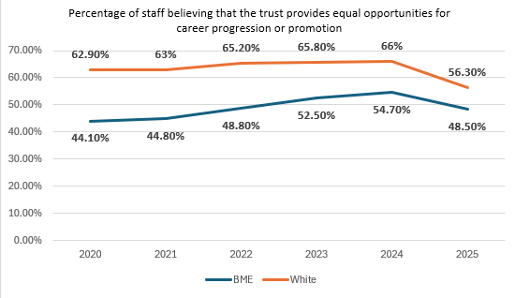
Indicator 8 WRES Staff Survey Data 2024
Percentage of staff believing that the trust provides equal opportunities for career progression or promotion
 |  | 2020 | 2021 | 2022 | 2023 | 2024 | 2025
Percentage of staff believing that the trust provides equal opportunities for career progression or promotion | BME | 44.1% | 44.8% | 48.8% | 52.5% | 54.7% | 48.5%
 | White | 62.9% | 63% | 65.2% | 65.8% | 66% | 56.3%
Confidence in equal career progression fell sharply in 2025 for both groups.
BME staff fell from 54.7% to 48.5%; White staff from 66.0% to 56.3%.
A 7.8 percentage-point gap remains.
Although the gap narrowed, this was mainly because White staff scores fell faster—not because BME staff improved.
Perceptions worsened across the workforce, with BME staff still less likely to believe opportunities are equal.
Action 1 and 3 in the action plan aims to support improvement with this indicator
Contents Page
Indicator 1
Indicator 2
Indicator 3
Indicator 4
Indicator 5
Indicator 6
Indicator 7
Indicator 8
Indicator 9

Slide 18
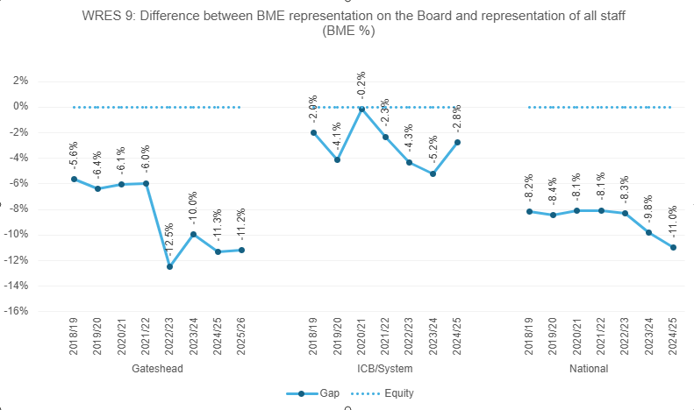
WRES Indicator 9
BME Board membership
Overall Board membership shows that as of March 2025, the difference between BME representation on the Board and the workforce was -11%. BME members were underrepresented by 1 as member of the Board.
Action 1 and 3 in the action plan aims to support improvement with this indicator
Contents Page
Indicator 1
Indicator 2
Indicator 3
Indicator 4
Indicator 5
Indicator 6
Indicator 7
Indicator 8
Indicator 9

Slide 19
WRES action plan
No | Action | WRES Indicator
1 | To reduce inequalities in recruitment, career progression, leadership development and access to opportunities. Strengthen Recruitment and Selection Policy so all recruitment at Band 8a and above and wherever possible at all levels, there is consideration for diversity of the applicants and reflect this within the panel representation i.e. interview panel members GEM backgrounds. Establish a targeted talent and succession programme for clinical global ethnic majority staff at bands 5 / 6 to increase confidence in applying for senior roles. Actively promote the CPD and development offer via staff networks to increase awareness of development opportunities beyond mandatory learning to enhance skills and in-turn, employability prospects. | Indicators 1, 2, 4, 8, 9
2 | To reduce experiences of bullying, harassment, discrimination and incivility. Arrange specific, targeted civility awareness sessions and FTSU sessions with all staff networks, to raise awareness and support confidence in raising concerns, incorporating changes to the grievance policy and let them know about triangulation meetings. Triangulate staff survey data where there are high levels of incivility reported through the staff survey, and high levels of protected characteristics to deliver targeted civility awareness sessions and offer managers support. Training for investigators on racism and racial harassment Training for commissioning managers on recognising bias, making decisions cases proceed to formal processes etc. | Indicators 7, 6, 5
3 | To strengthen leadership accountability and ensure EDI outcomes are embedded within organisational governance arrangements. Introduce / strengthen EDI objectives into Executive and senior leader appraisal arrangements, need to be aligned to the priorities and actions agreed within this paper. Develop a Non-Executive Director development programme to increase diversity Align a member of the executive team to the staff networks acting as an ally and a key contact outside of the Executive Director of People and OD Raise awareness of the governance arrangements around EDI with staff networks to assure them issues are tacked and discussed appropriately | Indicators 1, 2, 8, 9

