Slide 1
Welcome to Dunston Health Centre

Slide 2
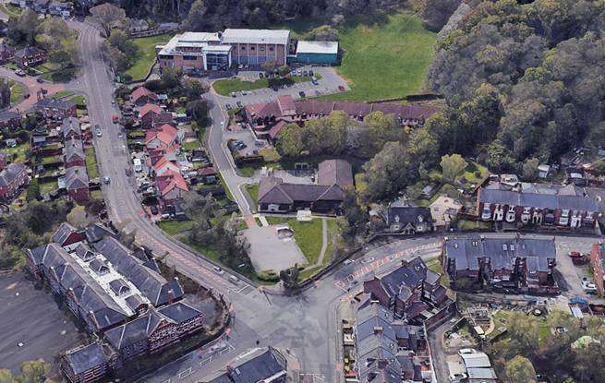
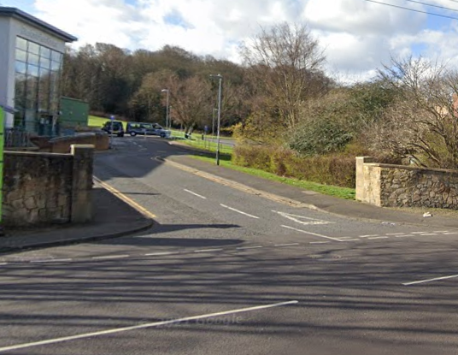
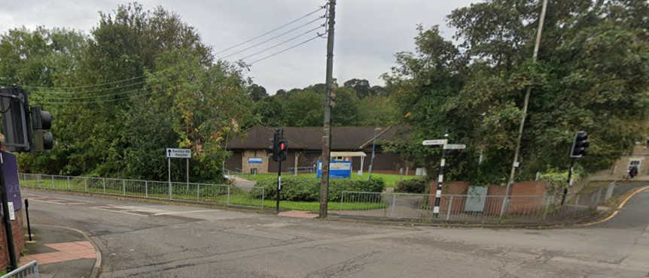
Dunston Health Centre - Arial View
Car access to Dunston Health Centre is via Dunston Bank
Turn into Dunston Leisure Centre and travel down to the car park
We are here
Pedestrian entrance

Slide 3
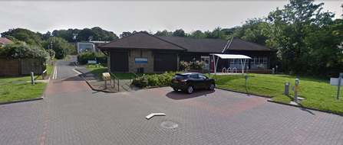
Dunston Health Centre- Car Park
Patient Parking facilities for Dunston Health Centre
Accessible parking is also available

Slide 4
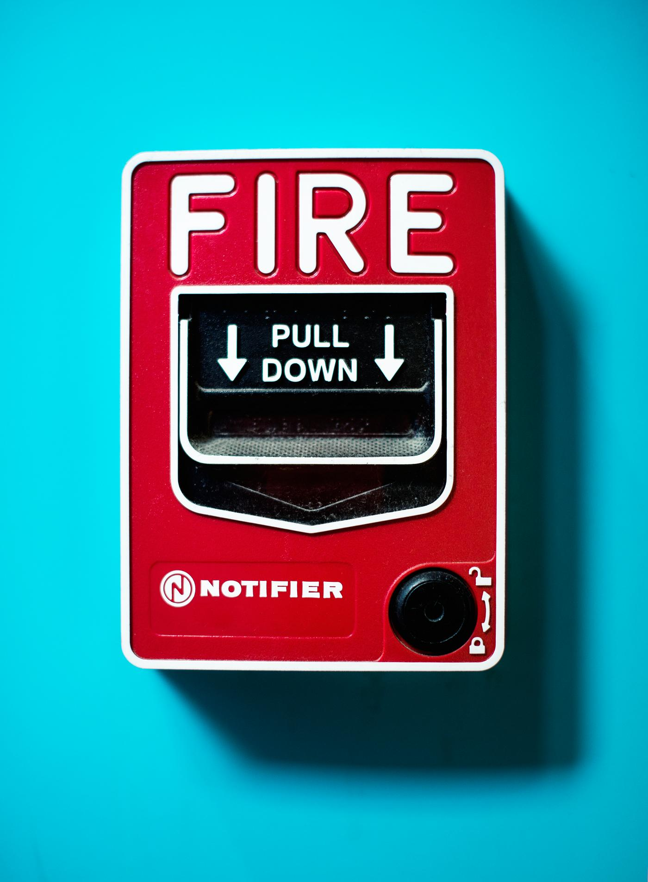
Welcome to Dunston Health Centre
Dunston Health Centre is open Monday to Friday for appointments only.
Some of the shutters may be down in the building, but the building will be open for your appointment.
Access to the Main Entrance is via the bottom car park.
Walk through the main entrance for entry into the building and turn right to the waiting area.
On a Wednesday mornings there is a fire alarm test, but will be made aware of this before the loud noise happens.
Press to hear the test Fire alarm
When the fire alarm sounds, a loud noise and message will be played through the speaker system throughout the Centre. This message can sound scary, but this is just a test.

Slide 5
We are currently working on our sensory garden.
Expected to bloom in 2025.

Slide 6
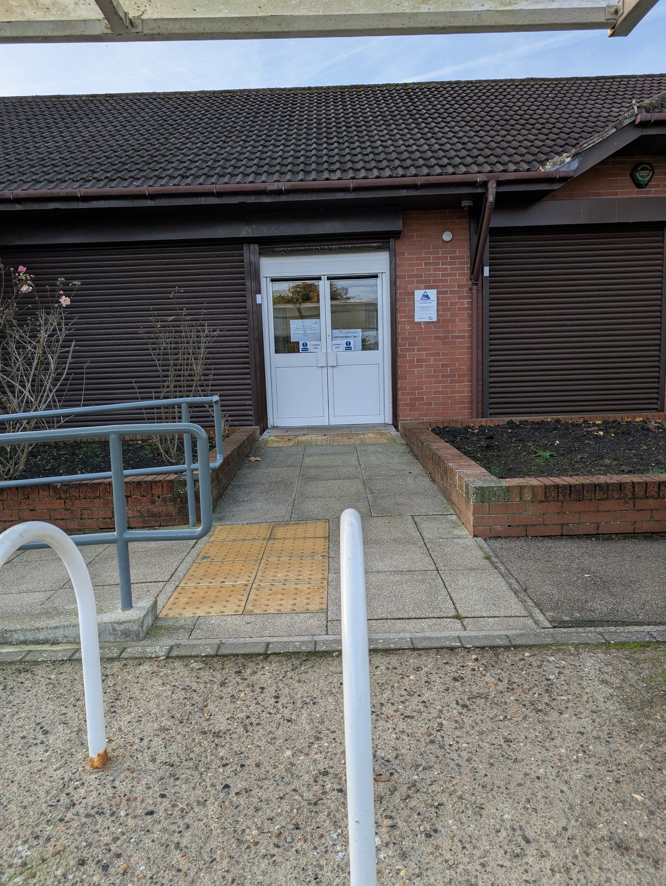
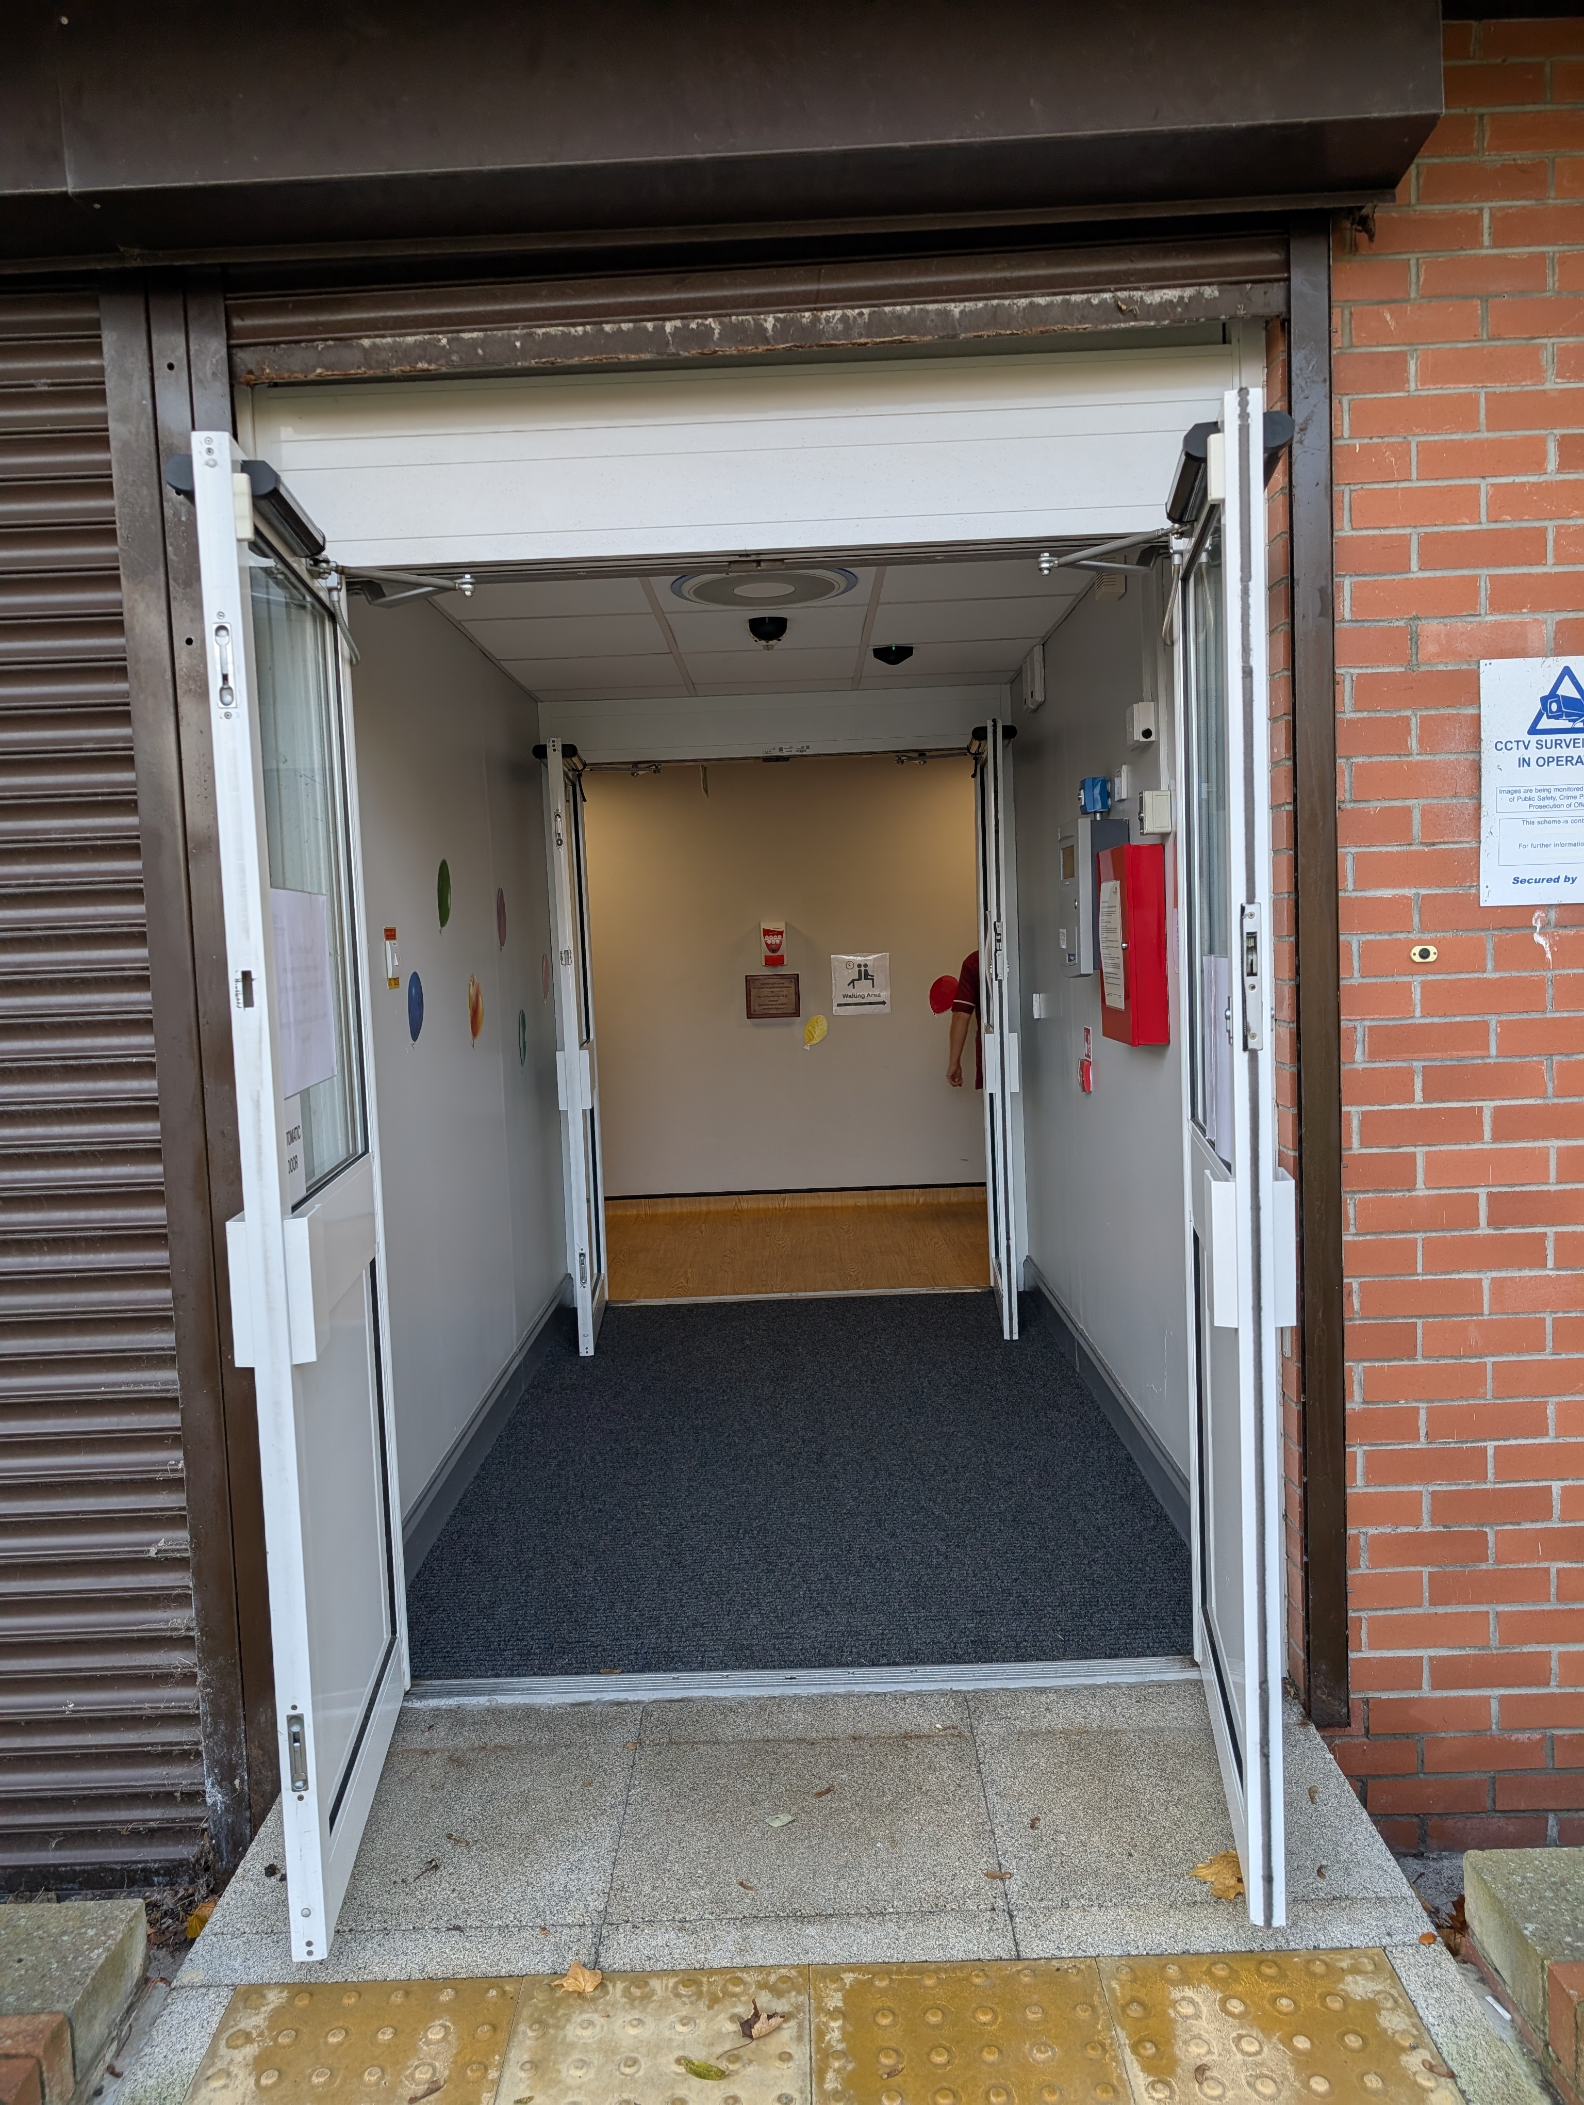
Main Entrance
To get into the building you will walk through 2 sets of doors which will open automatically.
Once through the doors, turn right to enter the waiting area.
There is no Receptionist, however someone will come and collect you at your appointment time.
Please sit and wait here for your appointment.
The Automatic doors can open suddenly, making noise and appears quite scary.

Slide 7
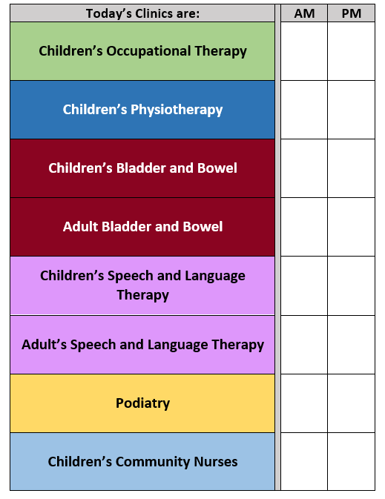
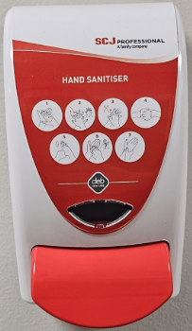
Waiting Area
There are seats located in the waiting area if you would like to take a seat and sit down.
There are information boards and leaflets from the different services who work within the building, please feel free to read them.
While waiting for your appointment there is an interactive caterpillar sensory board on the wall to play with.
There are a collection of children's books, located in the waiting area. So, feel free to grab a book and read while waiting for your appointment. If you're enjoying the book and don’t quite get it finished, please take it home to finish it there.
You may hear a radio while waiting for your appointment, set to a low level.
A notice board shows which Professionals are in the building
Hand sanitisers can be found located around the centre.
The radio should be playing, please feel free to ask a member of staff if you require the volume to be turned down.
The hand sanitiser can be a little sticky when rubbing It in.
The sanitiser may also have a strong smell.

Slide 8
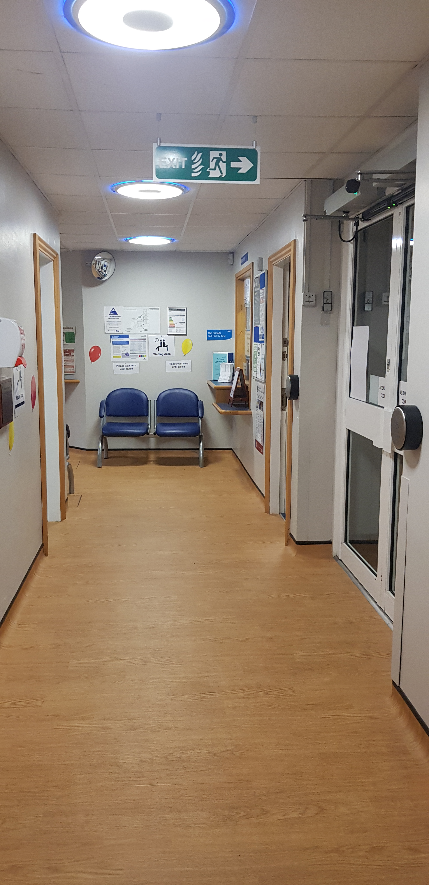
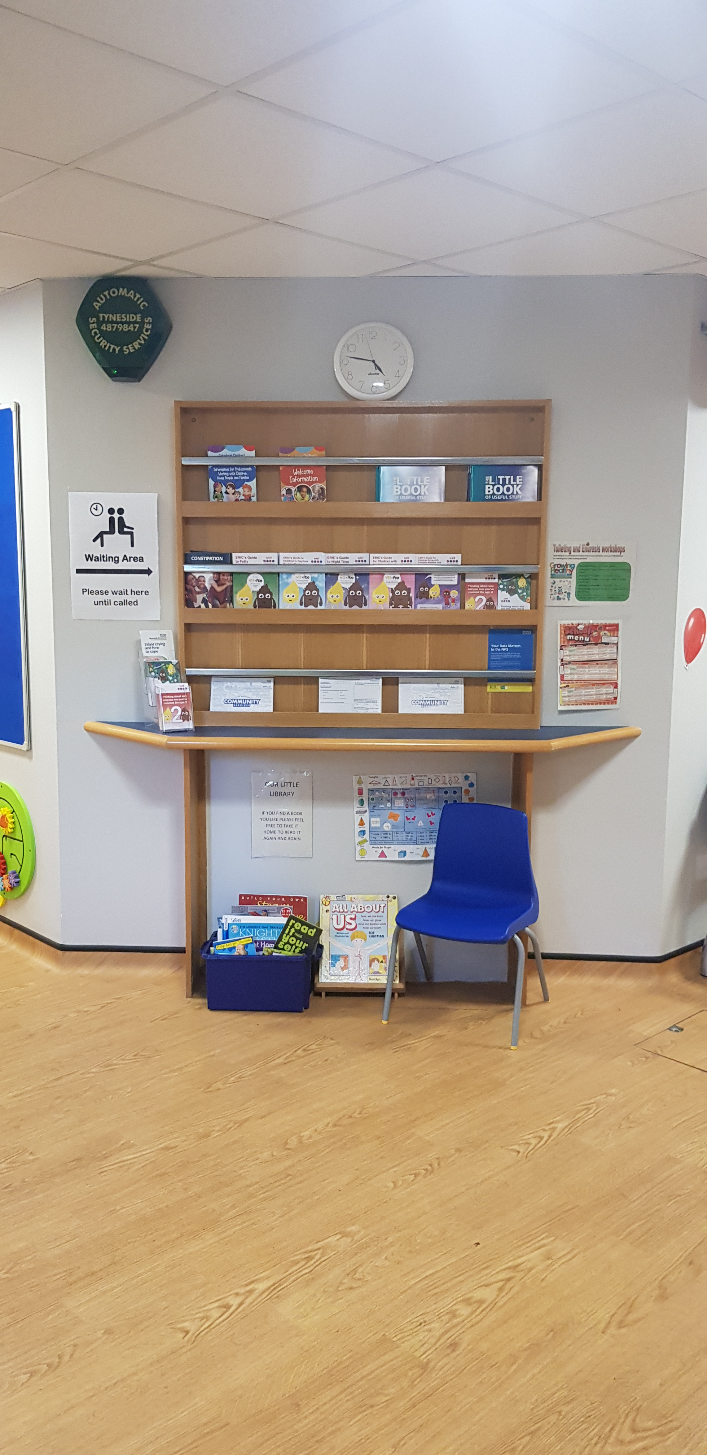
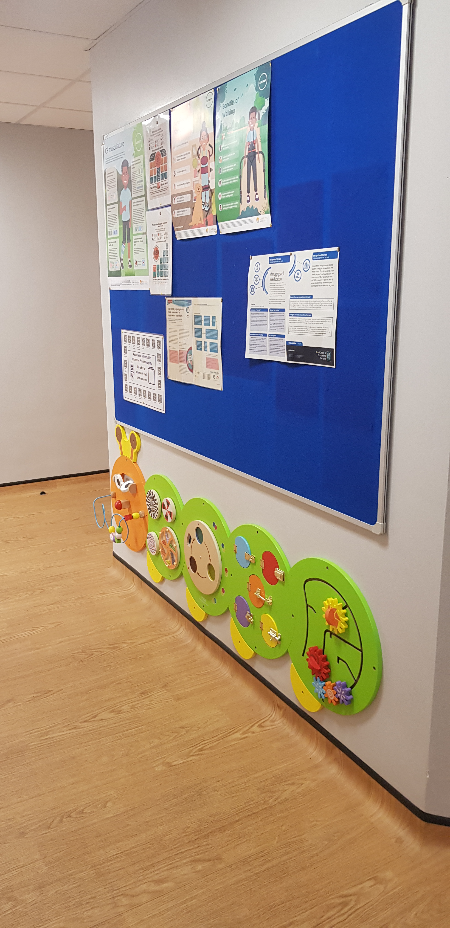
Waiting area

Slide 9
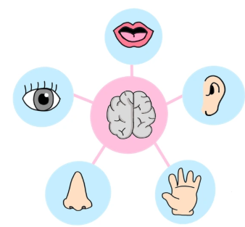
We are currently working on our sensory room

Slide 10
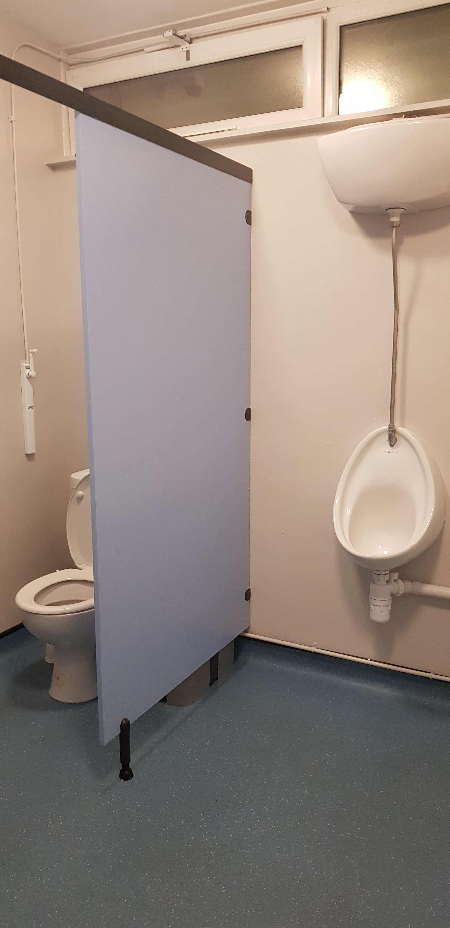
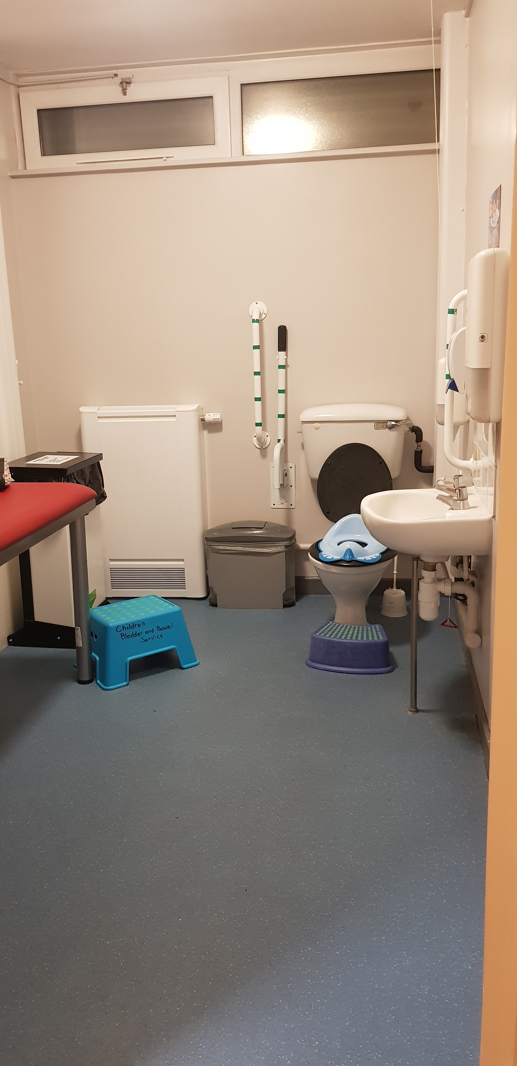
Toilets
When you enter the main building the toilet facilities are directly to the left.
There is an accessible toilet which includes a changing table.
These facilities are sensory friendly with paper towels and no electric hand dryers.

Slide 11
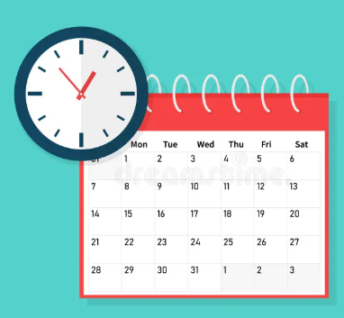
Do you need any reasonable adjustments?
Reasonable adjustments can be made, please contact us before your visit with us to discuss with the nurse how we can support you and your child.
Telephone 0191 4458417
Meet or chat in the car park / garden
Appointment time or day

