Slide 1
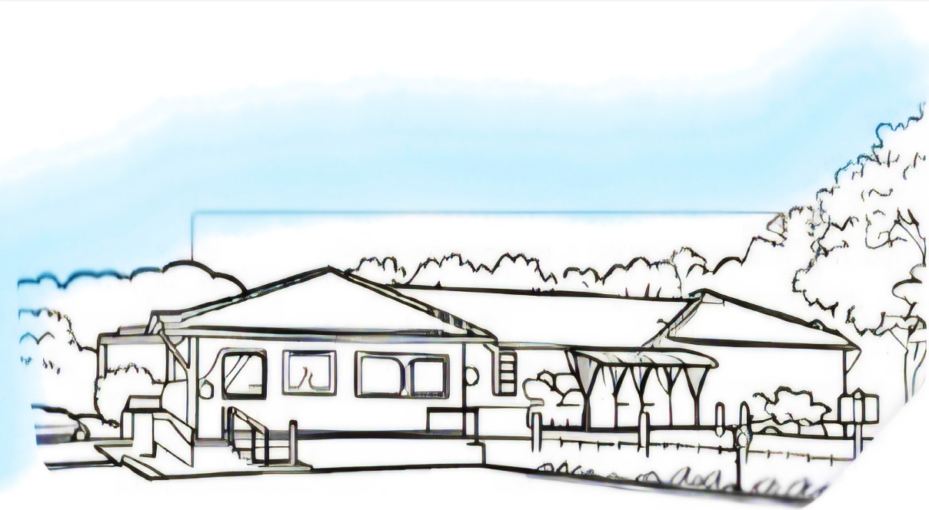
Bladder and Bowel service

Slide 2
Bladder and Bowel rooms
The two rooms we use for your appointments are set up a little different as you can see on the next two slides.
Both the rooms have chair's, a blue couch, a desk with a computer and a sink.
When you come in you can sit down or play with your toy/activity that you have brought with you.
There are information posters in both clinic rooms containing information about bladder and bowel health.

Slide 3
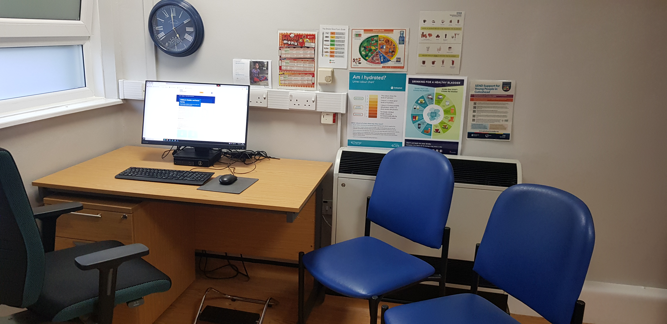
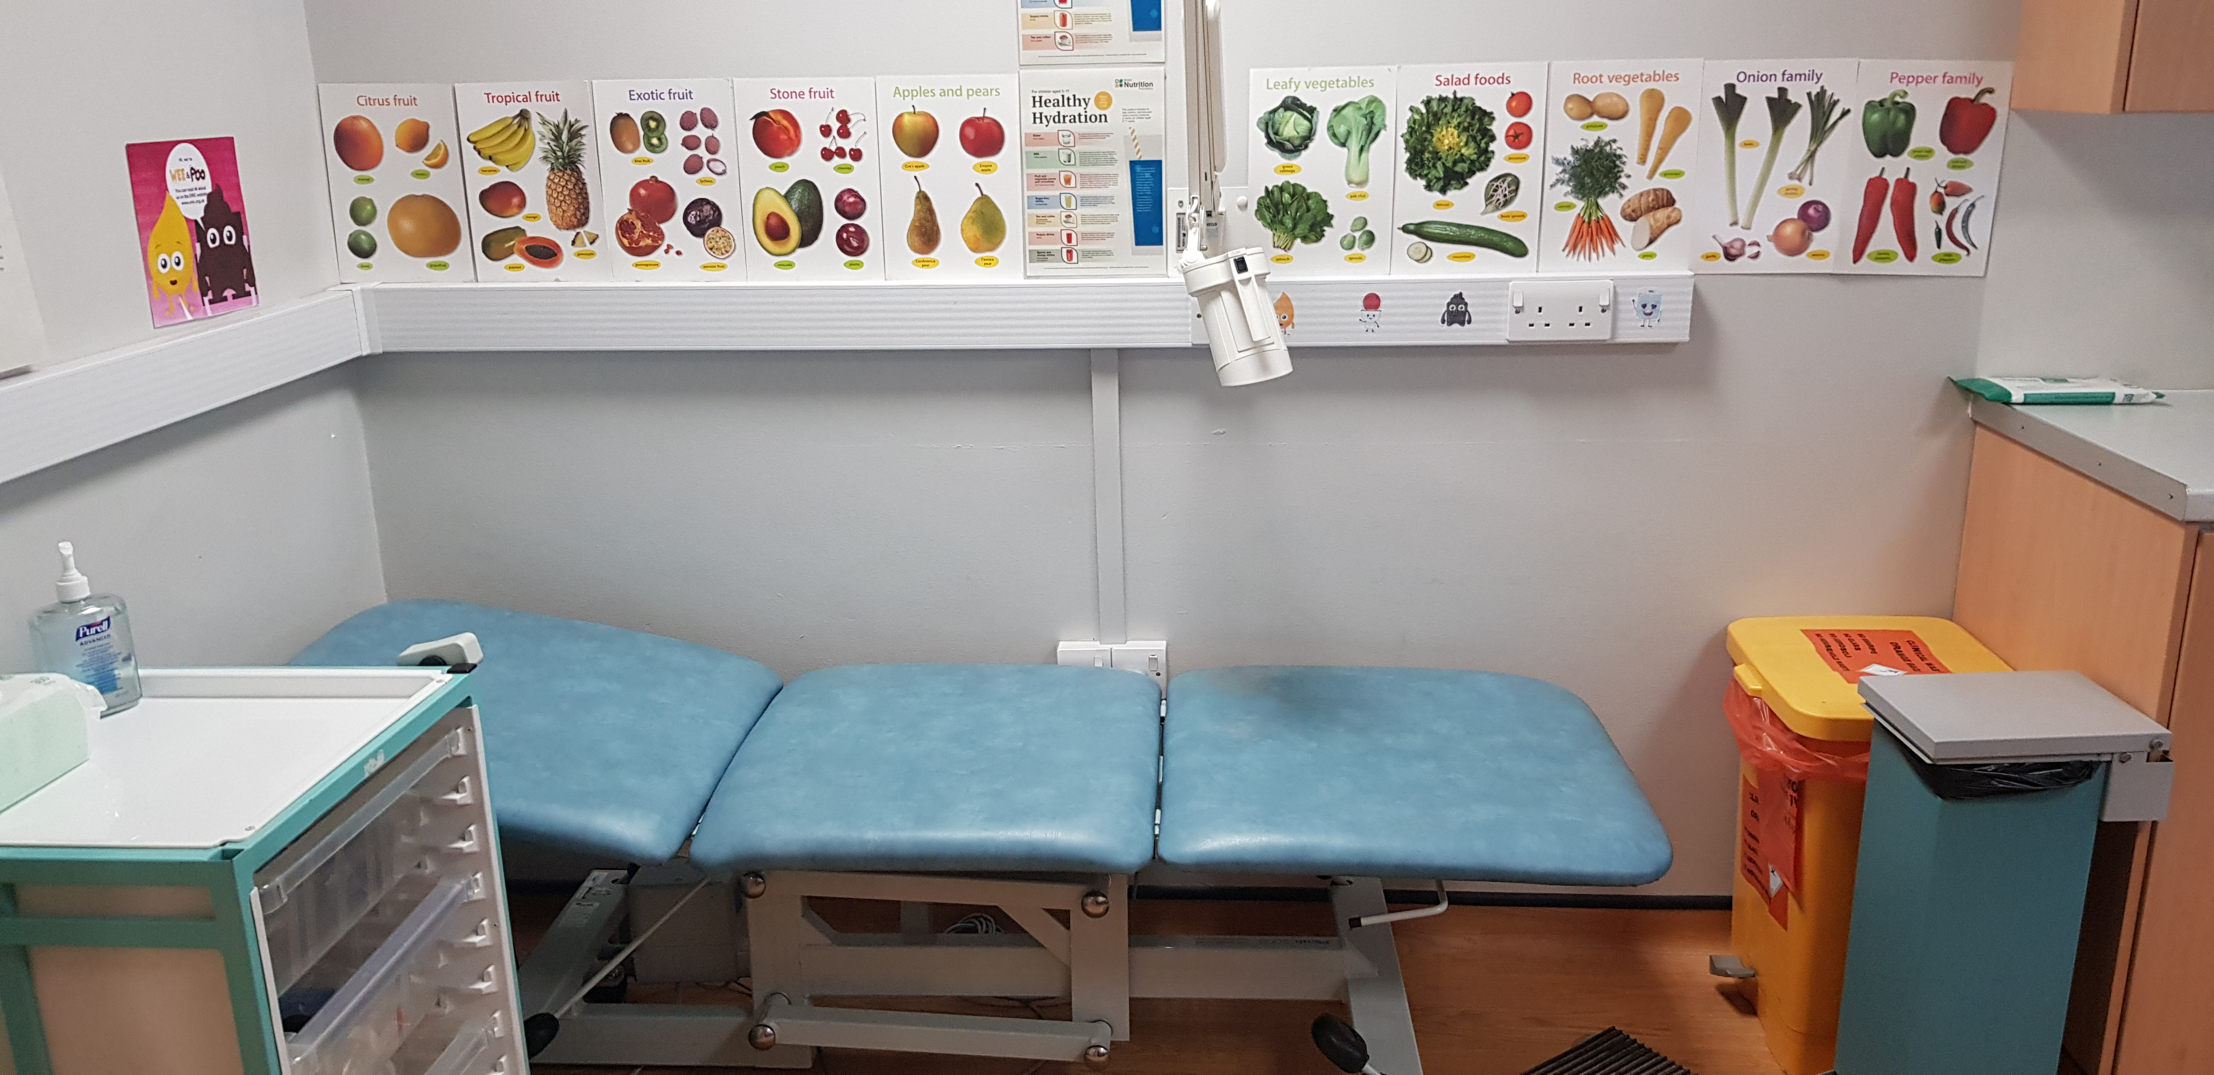
Clinic Room 1
Information
leaflets
Blue chairs
Desk with computer
Blue couch
Bladder and bowel scanner
(Listen to the sound )
The bladder scanner can make a scary, but this is to help the Nurse see how much you have emptied your bladder.
The hand sanitiser can be a little sticky when rubbing It in.
The sanitiser may also have a strong smell.

Slide 4
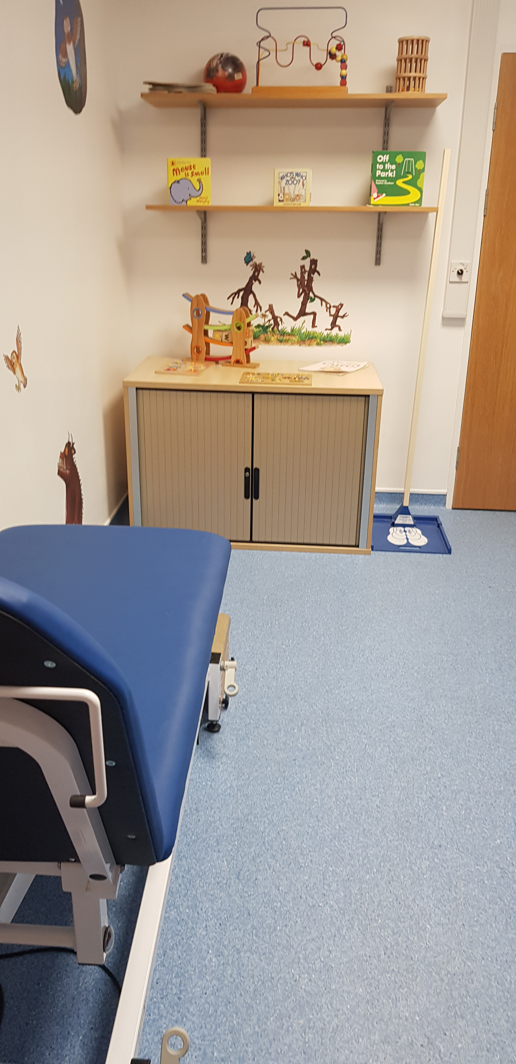
Clinic Room 2
Desk with computer
Blue couch
Blue chairs
Information
leaflets
Sink

Slide 5
The Bladder and Bowel Specialist Nurses Uniform
Your appointment is 90 minuets
(1½ hours)
In this time the Nurse will ask lots of questions which both you and the adult you have brought can answer.
As you are answering the questions the Nurse will type this information into the computer.

Slide 6
Abdominal Examination
If the Nurse may need to check how much Poo is in your body.
They will asked you to lie on the couch with your clothes on.
They will touch your tummy, they can do this through your clothes
This will not be painful

Slide 7
Bladder scan
If the Nurse needs to check how much wee is in your body, they will use this machine called a Bladder Scanner.
You will be asked to lie on our couch with your clothes on.
The Nurse will put some jelly on your skin which may be a little cold at first and then put the probe onto the jelly moving probe around your tummy.
Clink this symbol to hear the scanner noise when it's working.
The Nurse may ask you to have a wee after the scan and then do another scan to ensure all your urine went into the toilet.
The Nurse may test your wee to see if you are healthy
Please listen to the noise of the bladder scanner so it no longer looks or sound scary when we use it in clinic.
The bladder scanner helps the Nurse see how much wee is in your body before and after wee

Slide 8
Leaving the building
﻿
To leave the building you will walk through the 2 sets of doors which will open automatically.
Once through the doors, you are in the car park.

Slide 9
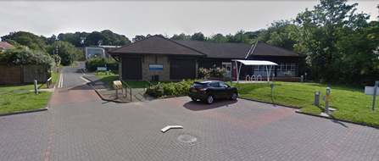
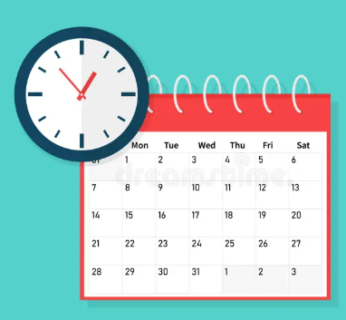
Do you need any reasonable adjustments?
Reasonable adjustments can be made, please contact us before your visit with us to discuss with the nurse how we can support you and your child.
Telephone 0191 4458417
Meet or chat in the car park / garden
Appointment time or day

